Slide 1


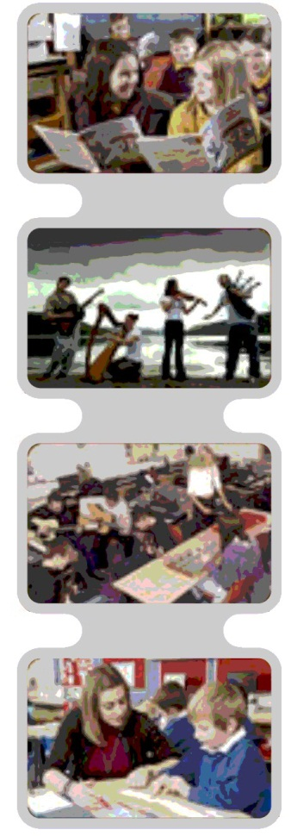
Building Vocabulary for Better Literacy
Literacy
Toolkit
HGIOS 4
Where does it link to How Good is Our School?
2.2 – Curriculum
2.3 – Learning, teaching and assessment
2.4 – Personalised support
Notes:
The notes section in each presentation is primarily for the facilitator, indicating additional requirements or information.
Building Vocabulary for Better Literacy
The objective of this PPT is to explore the research and strategies around pre-teaching vocabulary and relating this to improving literacy levels and learning outcomes for children and young people.
This PPT will address the following Quality Indicators from HGIOS 4:
QI: 2.2 – Curriculum – Themes:
Rationale and design
Development of the curriculum
Skills for learning, life and work
QI: 2.3 – Learning, teaching and assessment – Themes:
Learning and engagement
Quality of teaching
Planning, tracking and monitoring
QI: 2.4 – Personalised support – Themes:
Universal support
Removal of potential barriers to learning

Slide 2
Building Vocabulary for Better Literacy
Literacy
Toolkit
Agenda
Activity 1 – Introduction / Starter Activity (5 mins)
Activity 2 – How’s it going / feedback (10-20 mins)
Activity 3 – New Learning (25-40 mins)
Activity 4 – Personal Action Planning (10 mins)
Notes:
This agenda is fixed and is the same for every presentation in the toolkit.

Slide 3

Building Vocabulary for Better Literacy
Literacy
Toolkit
Activity 1: Spend 2-3 minutes teaching each other a new word –
Do NOT write your new word down
Following the task, discuss: What information did you have to provide?
Notes:
Get into pairs
Each person has to think of a new word to teach their partners. It could be a word from a different language or maybe a technical word that the other person has not heard of before. You could even make up a word. You must check that the other partner has no (or limited) prior knowledge of that word.
If you are stuck for words, try these:
Isinglass: a type of gelatin obtained from fish
Hamulus: A hook-like projection on a bee or wasp, linking the fore and hindwings
Mahonia: A type of bush native to eastern Asia and North and South America
Thenar: The fleshy part of the hand at the base of the thumb
Jabot: An ornamental ruffle on the front of a shirt or blouse
Spend 2-3 minutes teaching each other your new words – Do NOT write your new word down
Facilitator to pose the question: What information did you have to provide?
Facilitator to share: Some ideas might be:
A definition of the word
An example of the word in a sentence
A description or a drawing
Speaking slower so the partner can HEAR the sounds in the word
Getting your partner to repeat the word back to check it sounds right.
Can everyone remember their new words?
Can everyone use their new words in a sentence?
10 minutes

Slide 4
Building Vocabulary for Better Literacy
Literacy
Toolkit
Activity 2: How’s it going? – what we already know
By ages 3-6 years - a child’s narrative skills are a powerful predictor of literacy skill at 8-12 years.
By 4 years – the difference in the number of words children from disadvantaged backgrounds hear is 19 million
By 5 years – a child’s vocabulary will predict their educational success and outcomes at age 30
To discuss:
Can you think of one or two children in your class that have poor vocabulary skills? What is the impact of this on their literacy learning?
Notes:
Participants to discuss ~
Participants to be given 2 minutes to discuss – facilitator to collect responses.
Can you think of one or two children in your class that have poor vocabulary skills? What is the impact of this on their literacy learning?
Some answers may include:
Children from backgrounds with less stimulation/exposure
Children with Speech, Language and Communication Needs
Bilingual/ Multilingual learners (may have reduced vocabulary knowledge in English as this is an additional language)
Children with specific areas of interest and vocabulary knowledge but less general vocabulary knowledge (e.g. children with ASD)
Children with learning difficulties.
Impact on learning:
Children don’t understand simple literacy concepts e.g. beginning/middle/end, first/next/last, page, book, word, rhyme, etc.
Children don’t understand a group story and miss vital key learning opportunities
Children may be able to decode words but don’t understand their meanings so they are unable to read for meaning
Children have poor vocabulary and language skills so they are less able to generate ideas and stories of their own
Children have a limited vocabulary so may end up using the same words repetitively in their writing e.g. said instead of shouted, called, whispered, yelled, chatted etc.
Children find it very difficult to understand spoken language and lose interest in listening to spoken stories and other literacy learning opportunities
Children may become passive learners or develop behavioural difficulties
Children use ‘empty’ words (such as ‘thing’) when talking and struggle to give clear verbal ideas
If children are unable to give clear verbal ideas, then they will be unable to give a clear written structure
Children develop poor literacy skills and are then unable to access other learning (particularly in upper primary and secondary school).
References:
Wellman R.L., Lewis B.A., Freebairn L.A., Avrich A.A., Hansen A.J., and Stein C.M. (2011) Narrative Ability of Children With Speech Sound Disorders and the Prediction of Later Literacy Skills LSHSS 42;561-579
Hart, B., & Risley, R. T. (1995). Meaningful differences in the everyday experience of young American children. Baltimore: Paul H. Brookes
Leon Feinstein and Kathryn Duckworth (2006) Development in the early years: its importance for school performance and adult outcomes
10 minutes

Slide 5
Building Vocabulary for Better Literacy
Literacy
Toolkit
Why is vocabulary knowledge important for literacy?
“Children need to have a good vocabulary so that they can understand what the words they've read relate to. A weak vocabulary leaves children with a smaller reserve of sound and word knowledge and increased difficulties with decoding real words when they read.”
“Vocabulary is vital for comprehension, crucial for writing and content-area learning; and is an area of weakness for poor or reluctant readers.”
The research highlights that statistically children from disadvantaged backgrounds may be exposed to fewer words.
How are you currently supporting all learners in your classroom in their vocabulary development?
Notes:
Participants to read slide: 2 minutes
Participants to discuss: 4 minutes
Feedback collected: 3 minutes
References:
Wellman R.L., Lewis B.A., Freebairn L.A., Avrich A.A., Hansen A.J., and Stein C.M. (2011) Narrative Ability of Children With Speech Sound Disorders and the Prediction of Later Literacy Skills LSHSS 42;561-579
Snow C. (2011) The Potential of Discussion to Improve Reading Comprehension – Lecture IDA New York
Hart, B., & Risley, R. T. (1995). Meaningful differences in the everyday experience of young American children. Baltimore: Paul H. Brookes

Slide 6
Building Vocabulary for Better Literacy
Literacy
Toolkit
Activity 3: New Learning
How we learn new words
In order to store new words effectively, children need to gain knowledge about 3 key areas:
Word knowledge (semantics)
Phonological awareness
Kinaesthetic / visualisation
Notes:
Facilitator to share:
In addition to learning about these 3 key areas of every word, a child needs to hear new words approximately 50 meaningful times before they will start to use the words in their spoken vocabulary.
To make the words meaningful, it is helpful to have a visual representation (either an object, picture or physically doing the action).
It is not enough for the child to read a word. A child needs interaction and experience to learn language.
2 minutes

Slide 7
Building Vocabulary for Better Literacy
Literacy
Toolkit
How we learn new words
Word knowledge (semantics)
What is it?
What do we do with it?
Where do we find it?
What sort of thing is it? What group does it belong to?
  And for more able children:
  What category?
  What do you already know?
  What does it link with?
  Find a word which means the same / different
Notes:
Facilitator to share:
In order to store new words effectively, children need to gain knowledge about 3 key areas:
The first area is word knowledge (semantics).
All these questions relate to all the information a child needs to learn about a word to store it effectively.
1 minute

Slide 8
Building Vocabulary for Better Literacy
Literacy
Toolkit
How we learn new words
Phonological awareness
How many beats in the word? (syllables)
What sound does it begin with?
What does it rhyme with?
Is it a short, medium or long word?
Notes:
Facilitator to share:
The second area is phonological awareness (sound awareness).
1 minute

Slide 9
Building Vocabulary for Better Literacy
Literacy
Toolkit
How we learn new words
Kinaesthetic / visualisation
Can you do an action?
What does it look like?
Draw a picture
  And for more able children:
  Picture it in your head
Notes:
Facilitator to share:
The third area is kinaesthetic or visual information.
1 minute

Slide 10
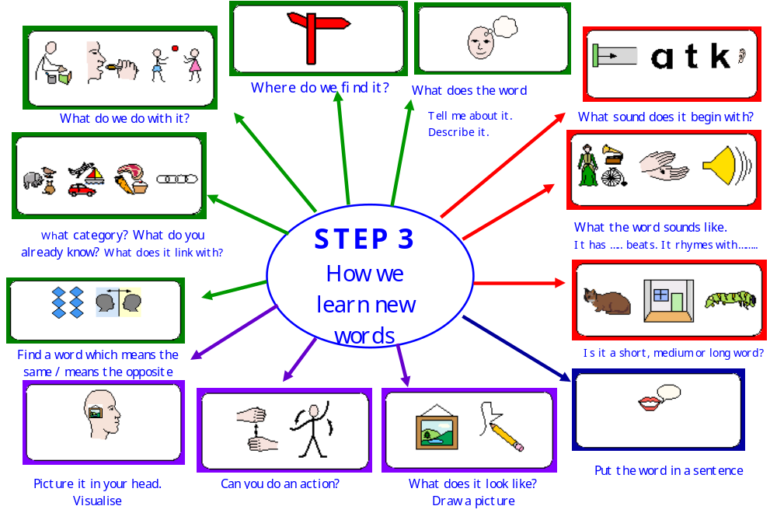
Building Vocabulary for Better Literacy
Literacy
Toolkit
Notes:
This poster is part of a set of progressive posters. This is an example of Step 3 for more able children. The other posters which can be used earlier on in a child’s development can be accessed:
https://www.widgit.com/resources/literacy-language/vocabulary/pre-teaching-vocabulary/ptvbooklet_for_schools_4th_edition_june2013.pdf
Facilitator to share:
This is a visual representation of the three key areas:
The questions with a green border relate to the word meaning
The questions with a red border relate to phonological awareness
The questions with a purple border relate to visual or kinaesthetic aspects of the word.
Images provided from the Pre-teaching Vocabulary resource by Pip St. John
This slide could be printed and enlarged for participants as a visual representation of the three key stages.
2 minutes

Slide 11
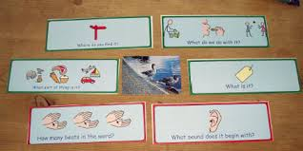
Building Vocabulary for Better Literacy
Literacy
Toolkit
How we learn new words
Notes:
Facilitator to share:
This is an example of how to introduce the word ‘duck’ using the key areas.
The questions with green borders relate to the word knowledge. The questions with red borders relate to phonological awareness.
1 minute

Slide 12
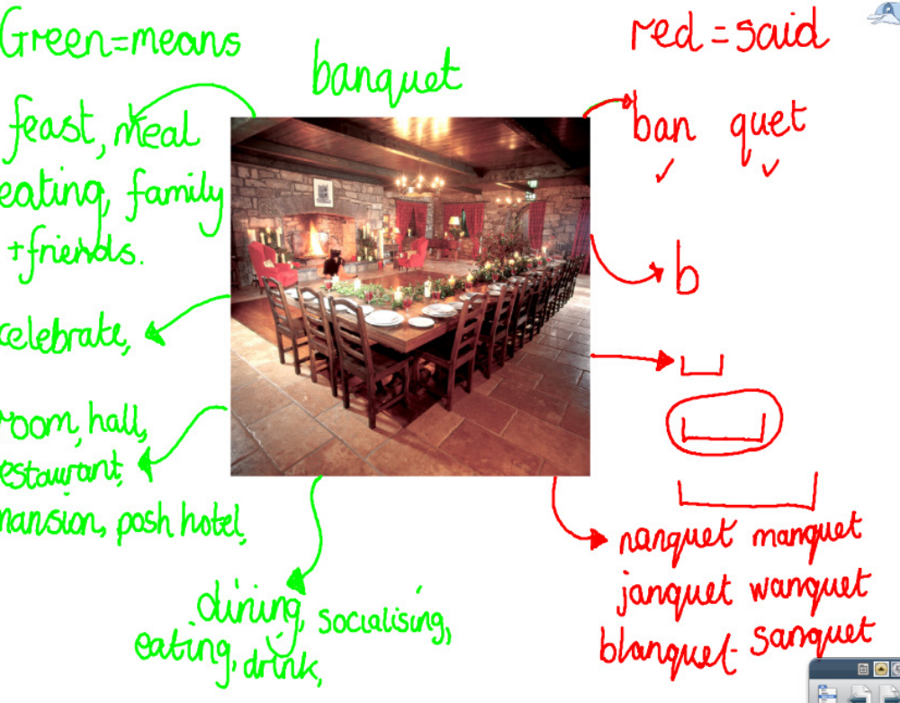
Building Vocabulary for Better Literacy
Literacy
Toolkit
Notes:
Facilitator to share:
This is an example of a WORD MAP for the word ‘banquet’ using the Smartboard.
The words in green relate to the word knowledge. The words in red relate to phonological awareness.
1 minute

Slide 13
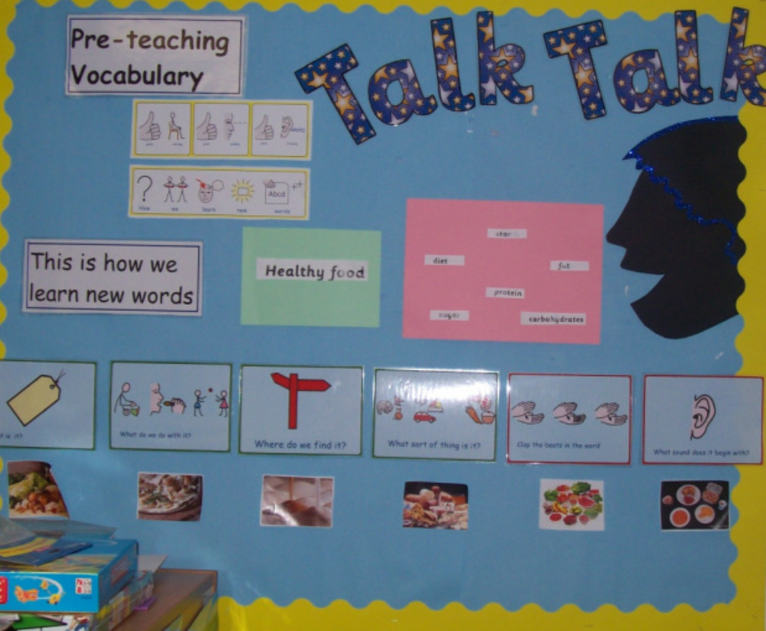
Building Vocabulary for Better Literacy
Literacy
Toolkit
Notes:
Facilitator to share:
This is an example of a class wall display using the key questions for word learning.
The display encourages the teacher and pupils to think about the key questions when learning new words.
1 minute

Slide 14
Building Vocabulary for Better Literacy
Literacy
Toolkit
Optional 20-30 minutes extension available now or skip to slide 21 to complete introductory presentation
Notes:
This can be done as an Optional 20 – 30 minute session, or revisited at a later date.

Slide 15
Building Vocabulary for Better Literacy
Literacy
Toolkit
How we learn new words ~ how to choose which words to teach
Tier 1 Words ‘anchor words’
These are basic words commonly used in spoken language
Heard frequently, often reinforced by non-verbal gestures and signs
Rarely require explicit explanations
e.g. Bed, happy, boy, hamburger, clock
Notes:
Facilitator to share:
Words can be split into 3 tiers depending on their complexity.
Thinking about which Tier a word falls into will help us decide if we need to pre-teach that vocabulary or not.
You may need to pre-teach some Tier 1 words to an individual child who has had limited exposure to (English) vocabulary and / or has significant ASN.
You are unlikely to have to pre-teach Tier 1 words to a whole class.
2 minutes

Slide 16
Building Vocabulary for Better Literacy
Literacy
Toolkit
How we learn new words ~ how to choose which words to teach
Tier 3 Words ‘step-on words’
Appear in more specialist situations
Rarely used in general everyday conversation
They tend to be limited to specific domains and subject areas
Tends to be specific vocabulary which must be taught as key words of the curriculum area being taught
e.g. metamorphosis, symmetrical, parallel, archaeologist
Notes:
2 minutes

Slide 17
Building Vocabulary for Better Literacy
Literacy
Toolkit
How we learn new words ~ how to choose which words to teach
Tier 2 Words ‘Goldilocks words’
These words are not considered as ‘common’ as Tier 1 Words
They appear in more specialist situations rather than general conversations.
They are not the most basic way to express an idea; they represent the more sophisticated vocabulary of the written word.
Including vivid verbs, adjectives, adverbs and specific or abstract nouns:
e.g. warm, darker, compare, gentle, obstacle, light
Notes:
Facilitator to share:
Working on tier 2 words has been proved to make the biggest difference to children’s understanding of a topic.
2 minutes

Slide 18
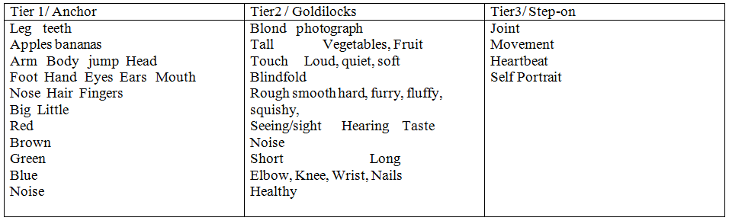
Building Vocabulary for Better Literacy
Notes:
Tiering vocabulary example from P1/2 class at Park Primary

Slide 19
Building Vocabulary for Better Literacy
Literacy
Toolkit
How we learn new words ~ how to choose which words to pre-teach
Think about one curriculum area/ topic first and select a range of words the children will need to know (including relevant verbs)
Divide the words into 3 categories using the idea of ‘tiers’
Working on tier 2 words can make the biggest difference to children’s understanding of a topic
Once familiar with the strategies you can then extend your use across a range of curriculum areas
Notes:
Facilitator to share:
This slide outlines the theory of teaching new words using the idea of 3 tiers (it is not a task to try now)
2 minutes

Slide 20
Building Vocabulary for Better Literacy
Literacy
Toolkit
An example of a Primary 1/2 class vocabulary list for the topic ‘plants’
Tier 1 | Tier 2 | Tier 3
Flower | Warmer / warmth | Energy
Digging | Wet | Germinating
Sun | Planting | Composting
Garden | Bulbs
Gloves | Rake
 | Petal
 | Light
Notes:
2 minutes

Slide 21
Building Vocabulary for Better Literacy
Literacy
Toolkit
How we learn new words ~ how to choose which words to teach
Tier 1 | Tier 2 | Tier 3
Notes:
Facilitator to share:
Spend 5 minutes thinking about one curriculum area/ topic:
Generate a list of vocabulary (20 + words)
Sort the vocabulary into the relevant tiers
Facilitator to collect responses.
10 minutes

Slide 22
Building Vocabulary for Better Literacy
Literacy
Toolkit
Notes:
Pick one or two topic vocabulary (Tier 2 – if you completed the extension) words and answer all the questions.
Think about how you could pre-teach these words.
Please note, if you picked a verb – you do not need to answer the question ‘what do we do with it?’
Provide 5 minutes to complete task. Facilitator to collect responses.
Just for fun ~
Can anyone remember their new word from the beginning of the session?
Can you use it in a sentence?
10 minutes

Slide 23
Building Vocabulary for Better Literacy
Literacy
Toolkit
Activity 4: Personal Action Planning
Select one curriculum area to focus on over the next month
Identify the techniques and strategies which would be most useful in your class
Share your action plan with a partner.
Bring back your findings to the next session
Notes:
Using the Personal Action plan sheet each teacher chooses one curriculum area to focus on over the next month. Think about the examples of pre-teaching vocabulary (using the question cards, creating WORD MAPs on the smartboard, using a whole class display). Which technique would be most useful in your class and how are you going to implement this?
This may involve doing more of some things and less of others and teachers may need pushing on this.
Activity 4: Personal Action Planning
Have copies of My Personal Action Plan ready to distribute
Pair-share: two minutes sharing your plan with your partner then swap.
Randomly choose two or three practitioners to share with the group what their partner is planning.
5 – 10 minutes

Slide 24





Building Vocabulary for Better Literacy
Literacy
Toolkit
FOLLOW UP LINKS:
Widgit Symbol Resources - Pre-teaching Vocabulary | Save the Children - Read On Get On | RALLI Campaign - YouTube
Videos of practice - Learning and teaching - THE JOURNEY TO EXCELLENCE | The Communication Trust | http://www.rcslt.org/
Notes:
FOLLOW UP LINKS
The facilitator should refer participants to the follow up links which can be accessed independently for further information.

