Slide 1



Read with Confidence
Literacy
Toolkit
HGIOS
2.1 – Learners’ Experiences
5.2 – Teaching for Effective learning
Notes:
The notes section in each presentation is primarily for the facilitator, indicating additional requirements or information. Please go to the following link for further info.
www.journeytoexcellence.org.uk/about/keydocuments/part3.asp
Read with Confidence
The objective of this PPT is to explore the research and views around developing ‘private’ and ‘public’ confidence in reading, and to generate professional dialogue and action relating to this with a view to improving experiences for the young people in school.
This PPT will address the following Quality Indicators from HGIOS 3
QI 2.1 Learners’ Experiences
The extent to which learners are motivated and actively involved in their own learning and development
QI 5.2 Teaching for effective learning
The learning climate and teaching approaches
Teacher-pupil interaction including learners’ engagement
Clarity and purposefulness of dialogue
Judgements made in the course of teaching

Slide 2
Read with Confidence
Literacy
Toolkit
Agenda
Activity 1 – Introduction / Starter Activity (5 mins)
Activity 2 – How’s it going / feedback (10 mins)
Activity 3 – New Learning (40 mins)
Activity 4 – Personal Action Planning (5 mins)
Notes:
This agenda is fixed and is the same for every presentation in the toolkit.

Slide 3

Read with Confidence
Literacy
Toolkit
Activity 1: Voice on the table
In a maximum of 30 seconds, share your thoughts on the image below.
Notes:
Participants to discuss:
In a maximum of 30 seconds, share your thoughts on the image below
The role of the teachers when it is not their turn is active listening
You may use a stopwatch
Choose respondents to share their opinion -everyone must be involved in this activity
Max 5 Minutes for this activity

Slide 4
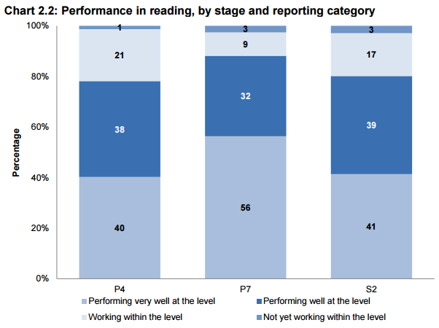
Read with Confidence
Literacy
Toolkit
Activity 2: How’s it going?
SSLN Results: Reading Attainment 2014
The percentage of pupils not yet working within their respective levels is small, but increases between P4 and S2.
Notes:
The Scottish Summary of Literacy and Numeracy (SSLN) 2014 found, with regards to reading, that the attainment of pupils not yet working within their respective levels is small, but increases between P4 and S2.
Participants to discuss:
What are the possible factors that may contribute to this increase?
Participants to be given 2 minutes to discuss – facilitator to collect responses.
Some suggestions may include:
“Development: By age 5 – 6 years children know between 5 – 8,000 words before starting to read.
After age 5, children acquire an additional 1,000 word families each year (e.g. dress, dressed, dressing) (Nation, 2001; Grabe, 2009)
Losing interest in reading for enjoyment – Check out the IPICK Strategy - http://highlandliteracy.com/2014/08/29/choosing-a-good-fit-text/
Phonics reading recovery programme unsuccessful – Could try Speedy Readers/ The Literacy Toolbox programme as an intervention
5 minutes

Slide 5
Read with Confidence
Literacy
Toolkit
Activity 2: How’s it going?
‘Private’ and ‘Public’ confidence
“An important self-development strategy uncovered in the children’s reports was the need to ‘practise your private confidence’ before you could develop ‘public confidence’. Children identified reading aloud and writing as activities requiring ‘public confidence’, and needed a lot of ‘private’ practice.”
Kellett,M and Aqsa,D (2007) ‘Children researching links between poverty and literacy’. York: Joseph Rowntree Foundation
Notes:
The following quote comes from an article published by the Joseph Rowntree Foundation in which young people conducted a number research studies to look at learners’ perceptions of literacy.
Facilitator to share the quote with participants and participants to discuss:
What opportunities are you currently providing to develop ‘private’ practice to enhance public confidence in reading?
Facilitator to provide 2 minutes for partner discussion and collect responses.
5 minutes

Slide 6
Read with Confidence
Literacy
Toolkit
Activity 3: New Learning
Public
Low ‘Private Confidence’
High ‘Public Confidence’
High ‘Private Confidence’
High ‘Public Confidence’
Private
Low ‘Private Confidence’
Low ‘Public Confidence’
High ‘Private Confidence’
Low ‘Public Confidence’
Notes:
Facilitators to share:
Learners may have different levels of ‘private’ and ‘public’ confidence when reading individually, to a partner or aloud to the class.
We will now look at each of these in more depth.
2 minutes

Slide 7
Read with Confidence
Literacy
Toolkit
Activity 3: New Learning
Public
Private
Low ‘Private Confidence’
Low ‘Public Confidence’
Sarah
Notes:
Facilitators to share:
Sarah is in your class. During recent standardized testing she scored an average reading score 2 and a half years below her age. When reading in class she often stumbles over words in the passage, lacking fluency and demonstrating poor decoding skills. Her comprehension score was 6 months below her age; however, she struggles to infer meaning and articulate her answers in a large group as she is worried about getting the answer wrong.
How could you support Sarah?
Participants to be given 3 minutes to discuss – feedback collected by facilitator.
Some suggestions may include:
A programme of reading recovery e.g. Speedy Readers
Daily reading with an adult to develop fluency
Supporting learners in the Early Level as a ‘peer reading buddy’
Allowing time to discuss her thoughts on a text with a partner before sharing with the class
Revisit previously read texts to build up fluency when reading aloud
Send the text home with Sara.
7 minutes

Slide 8
Read with Confidence
Literacy
Toolkit
Activity 3: New Learning
Public
Marc
Low ‘Private Confidence’
High ‘Public Confidence’
Private
Notes:
Facilitators to share:
Marc is in your class. During his standardized testing he rated reading as a 1 – something he disliked across the curriculum. He has a reading age 16 months behind his age. When put in a group, Marc has developed strategies to avoid reading the text; however, contributes to the group discussion by listening attentively and is eager to answer questions based on the group’s response – as opposed to his own. Marc has identified that he wants to become a ‘better reader’.
How could you support Marc?
Participants to be given 3 minutes to discuss – feedback collected by facilitator.
Some suggestions may include:
Encourage Marc to take texts home prior to the lesson to read and discuss with his parents
Enquire about Marc’s reading for enjoyment – what does he like to read?
Encourage Marc to provide his own answers to the text
Provide opportunities to read the passage aloud within the safety of a partner/small group
A programme of reading recovery e.g. Speedy Readers
Listen to oral texts to support comprehension.
7 minutes

Slide 9
Read with Confidence
Literacy
Toolkit
Activity 3: New Learning
Public
Private
High ‘Private Confidence’
Low ‘Public Confidence’
Aimee
Notes:
Facilitators to share:
Aimee is in your class and is an avid reader. During recent standardized testing her average reading score was 2 years above her age. When discussing with an adult, her comprehension of the text is excellent. Aimee is reluctant to read aloud in a small group or to the class. She is a quiet individual who is eager to please the teacher.
How could you support Aimee?
Participants to be given 3 minutes to discuss – feedback collected by facilitator.
Some suggestions may include:
Supporting younger learners as a ‘peer reading buddy’
Identify a ‘reading partner’ in the class to read aloud daily in a secure environment
‘Check-in’ with Aimee during comprehension work, celebrating her ‘private’ success, providing her opportunities to share with a larger group
Provide Aimee with opportunities to talk about areas that she’s confident about with her ‘reading partner’
Provide Aimee with opportunities to paraphrase her reading partner’s response to a text to instil ‘public’ confidence without focusing on her own answers
Encourage Aimee to film herself reading to share with the class
Provide support strategies during group and whole-class reading, e.g. partner to take over if she is anxious.
7 minutes

Slide 10
Read with Confidence
Literacy
Toolkit
Activity 3: New Learning
Max
Public
High ‘Private Confidence’
High ‘Public Confidence’
Private
Notes:
Facilitators to share:
Max is in your class. He is a proficient reader, achieving a reading age of 10 months above his age. He is able to read fluently in groups/to the class and actively engages in discussions about the text. He enjoys reading for enjoyment and has a particular interest in graphic novels.
How can you ensure that Max is challenged and remains in this quadrant?
Participants to be given 3 minutes to discuss – feedback collected by facilitator.
Some suggestions may include:
Guide Max to appropriate texts for enjoyment
Develop Higher Order Thinking Skills to allow him to question and reflect on texts in depth
Support Max to transfer the skills he’s learned in reading into writing
Provide Max with opportunities to work with younger learners as a ‘reading buddy’ to share skills
Develop opportunities for max to work alongside other avid readers, e.g. Book Club, Reviewer of a school magazine/ podcasts, joining a debating club.
7 minutes

Slide 11
Read with Confidence
Literacy
Toolkit
Activity 3: New Learning
Public
Low ‘Private Confidence’
High ‘Public Confidence’
High ‘Private Confidence’
High ‘Public Confidence’
Private
Low ‘Private Confidence’
Low ‘Public Confidence’
High ‘Private Confidence’
Low ‘Public Confidence’
Notes:
Each practitioner to be given the blank Private/Public Confidence grid with the headings at the top. Practitioners to place each of their learners into the relevant quadrants with regards to reading confidence and share their findings with a partner.
5 minutes

Slide 12
Read with Confidence
Literacy
Toolkit
Activity 4: Personal Action Planning
Select one of the quadrants that you’re wanting to focus on over the coming weeks.
Identify strategies that you’re going to use with these learners to support/challenge their reading confidence.
Share your action plan with a partner.
Bring back your findings to the next session
Notes:
Using the Personal Action plan sheet each practitioner chooses one quadrant that they’re going to focus on over the coming weeks. Practitioners should identify strategies that they’re going to use to support/challenge these learners.
Activity 4: Personal Action Planning
Have copies of My Personal Action Plan ready to distribute
Pair-share: two minutes sharing your plan with your partner then swap.
Randomly choose two or three teachers to share with the group what their partner is planning.
It may be an idea to identify quadrant support partners – two/three people developing strategies for the same quadrant to provide support.
5 minutes

Slide 13
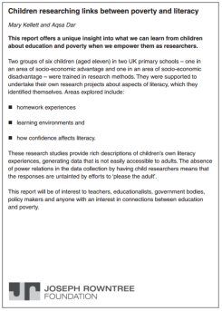

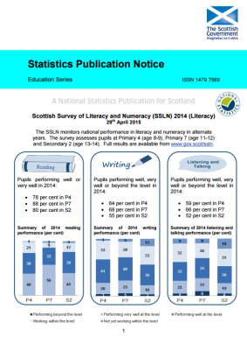
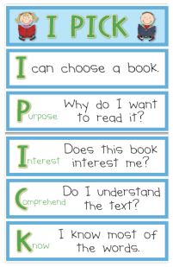

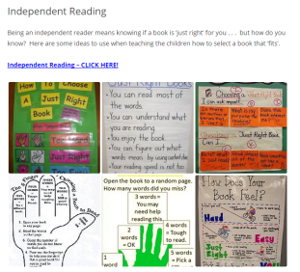
Read with Confidence
Literacy
Toolkit
FOLLOW UP LINKS:
Joseph Rowntree Foundation - Literacy Research | Save the Children - Read On Get On | SSLN (2014) Results
Choosing a 'good fit' text | Speedy Readers – The Literacy Toolbox | Independent Reading
Notes:
FOLLOW UP LINKS
The facilitator should refer participants to the follow up links which can be accessed independently for further information.

