Slide 1



Talk with Confidence
Literacy
Toolkit
HGIOS 4
Where does it link to How Good is Our School?
2.2 – Curriculum
2.3 – Learning, teaching and assessment
2.4 – Personalised support
Notes:
The notes section in each presentation is primarily for the facilitator, indicating additional requirements or information.
Talk with Confidence
The objective of this PPT is to explore the research and views around developing ‘individual’ and ‘group’ confidence when talking, and to generate professional dialogue and action relating to this with a view to improving experiences for the young people in school.
This PPT will address the following Quality Indicators from HGIOS 4:
QI: 2.2 – Curriculum – Themes:
Rationale and design
Development of the curriculum
Skills for learning, life and work
QI: 2.3 – Learning, teaching and assessment – Themes:
Learning and engagement
Quality of teaching
Planning, tracking and monitoring
QI: 2.4 – Personalised support – Themes:
Universal support
Removal of potential barriers to learning

Slide 2
Talk with Confidence
Literacy
Toolkit
Agenda
Activity 1 – Introduction / Starter Activity (5 mins)
Activity 2 – How’s it going / feedback (10 mins)
Activity 3 – New Learning (40 mins)
Activity 4 – Personal Action Planning (5 mins)
Notes:
This agenda is fixed and is the same for every presentation in the toolkit.

Slide 3

Talk with Confidence
Literacy
Toolkit
Activity 1: Voice on the table
In a maximum of 30 seconds, share your thoughts on the image below.
Notes:
Participants to discuss:
In a maximum of 30 seconds, share your thoughts on the image below
The role of the teachers when it is not their turn is active listening
You may use a stopwatch
Choose respondents to share their opinion -everyone must be involved in this activity
Max 5 Minutes for this activity

Slide 4
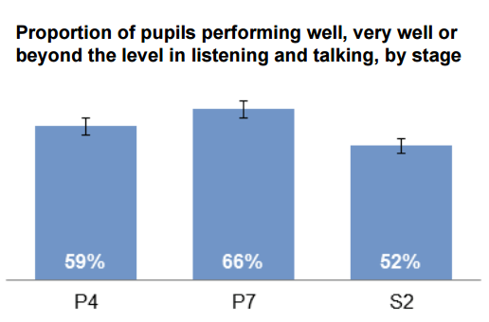
Talk with Confidence
Literacy
Toolkit
Activity 2: How’s it going?
SSLN Results: Listening and Talking Attainment 2014
56% at P4, 66% at P7 and 52% at S2 were performing well, very well or beyond the level for their stage in Listening and Talking.
What about the 41% (P4), 34% (P7) and 48% (S2) who are not?
Notes:
The Scottish Summary of Literacy and Numeracy (SSLN) 2012 found, with regards to listening and talking, that 56% at P4, 66% at P7 and 52% at S2 were performing well, very well or beyond the level for their stage.
Participants to discuss:
What about the 41% (P4), 34% (P7) and 48% (S2) who are not?
Participants to be given 2 minutes to discuss – facilitator to collect responses.
Some suggestions may include:
“Development: By age 5 – 6 years children know between 5 – 8,000 words before starting to read.
After age 5, children acquire an additional 1,000 word families each year (e.g. dress, dressed, dressing) (Nation, 2001; Grabe, 2009)
Higher Order Thinking Skills need purposeful planning
Social Skills teaching needs to be purposefully planned
Independence in listening and talking activities needs to be fostered
Listening and talking skills need to be developed across the curriculum.
5 minutes

Slide 5
Talk with Confidence
Literacy
Toolkit
Activity 3: New Learning
Individual Talk
High ‘Individual Talk Confidence’
Low ‘Group Talk Confidence’
High ‘Individual Talk Confidence’
High ‘Group Talk Confidence’
Group Talk
Low ‘Individual Talk Confidence’
Low ‘Group Talk Confidence’
Low ‘Individual Talk Confidence’
High ‘Group Talk Confidence’
Notes:
Facilitators to share:
Learners may have different levels of confidence when talking independently and in a group.
Each practitioner to be given the blank Talk Confidence grid with the headings at the top. Practitioners to place each of their learners into the relevant quadrants with regards to talk confidence and share their findings with a partner.
10 minutes

Slide 6

Talk with Confidence
Literacy
Toolkit
Activity 3: New Learning
Individual Talk
High ‘Individual Talk Confidence’
Low ‘Group Talk Confidence’
Group Talk
Low ‘Individual Talk Confidence’
Low ‘Group Talk Confidence’
Notes:
Our Bullseye: We want all learners to talk independently and in a group with confidence.
To support Group Talk, engage with the following PowerPoints from The Literacy Toolkit:
Group Talk Feedback – A Focus on the Individual
http://highlandliteracy.com/literacy-toolkit/group-talk-feedback-a-focus-on-the-individual/
Developing Thinking
http://highlandliteracy.com/developing-thinking/
2 minutes – each PowerPoint will require 1 hour (subsequent group or individual CPD)

Slide 7
Talk with Confidence
Literacy
Toolkit
Activity 3: New Learning
Individual Talk
Group Talk
Low ‘Individual Talk Confidence’
Low ‘Group Talk Confidence’
Low ‘Individual Talk Confidence’
High ‘Group Talk Confidence’
Notes:
Our Bullseye: We want all learners to talk independently and in a group with confidence.
Provide practitioners with the Generating Spoken Language Game hand out.
Practitioners to be given 3 minutes to read independently and 3 minutes to share their understanding of the game with a partner.
Facilitator – 2 minutes to collect responses.
8 minutes

Slide 8
Talk with Confidence
Literacy
Toolkit
Activity 3: New Learning
Generating Spoken Stories Game
This is an oral language task – NB: no pen and paper required
Learners to be arranged into groups of six. Each learner generates one idea each to create a group story.
Each idea focuses on one narrative concept:
1. When – e.g. ‘It was a cold and frosty day.’
2. Who - e.g. ‘A little, friendly girl with curly blonde hair.’
3. Where – e.g. ‘(She) was standing in a big park, looking up at a tree.’
4. What happened (the problem) – e.g. ‘An enormous, fluffy cat had climbed all the way to the top of the tree and couldn’t get down.’
5. What happened (the solution) – e.g. ‘The little girl called her Father on her mobile phone to ask if he could bring a ladder.’
6. The end – e.g. ‘The Dad came with a big, rusty, old ladder and rescued the cat which promptly ran away.’
Notes:
Facilitator to organise the participants into groups, sharing this slide.
Facilitator then to give time to practise and then share with the wider group.
10 minutes

Slide 9
Talk with Confidence
Literacy
Toolkit
Activity 3: New Learning
Reflecting on the previous task:
How could you use/adapt this activity for your learners?
How would you organise your groups?
How would you introduce each of the six key areas?
How do you see this developing across the curriculum?
Notes:
Reflecting on the previous task:
How could you use/adapt this activity for your learners?
How would you organise your groups?
How would you introduce each of the six key areas?
How do you see this developing across the curriculum?
Participants to be given time to discuss this and facilitator to collect responses.
5 minutes

Slide 10
Talk with Confidence
Literacy
Toolkit
Activity 4: Personal Action Planning
Over the coming weeks, look for opportunities to prioritise individual talk within literacy.
Choose an element that you are going to explore and evaluate.
Bring back your findings to the next session
Notes:
Using the Personal Action plan sheet each practitioner chooses an aspect that they’re going to focus on over the coming weeks. Practitioners should identify strategies that they’re going to use to support/challenge these learners.
Activity 4: Personal Action Planning
Have copies of My Personal Action Plan ready to distribute
Pair-share: two minutes sharing your plan with your partner then swap.
Randomly choose two or three teachers to share with the group what their partner is planning.
5 minutes

Slide 11
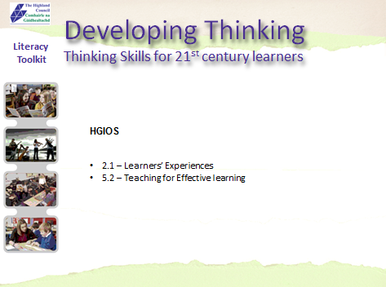

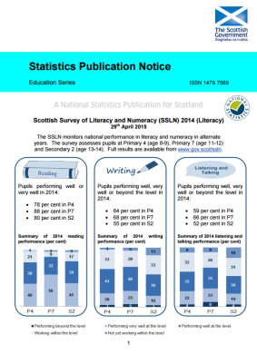
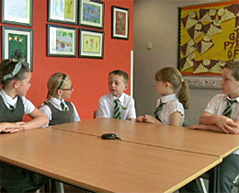
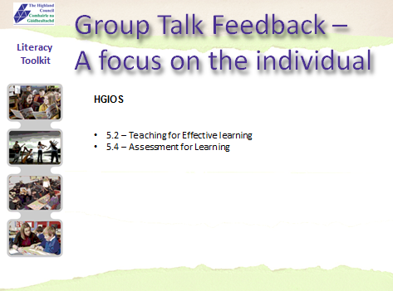

Talk with Confidence
Literacy
Toolkit
FOLLOW UP LINKS:
Developing Thinking – The Literacy Toolkit | Spoken Language Game | SSLN (2014) Results
SSLN – Professional Learning Resource | Group Talk – A focus on the individual | ICAN – Free Resources for practitioners
Notes:
FOLLOW UP LINKS
The facilitator should refer participants to the follow up links which can be accessed independently for further information.

