Slide 1



Write with Confidence
Literacy
Toolkit
HGIOS 4
Where does it link to How Good is Our School?
2.2 – Curriculum
2.3 – Learning, teaching and assessment
2.4 – Personalised support
Notes:
The notes section in each presentation is primarily for the facilitator, indicating additional requirements or information.
Write with Confidence
The objective of this PPT is to explore the research and views around developing ‘private’ and ‘public’ confidence in writing, and to generate professional dialogue and action relating to this with a view to improving experiences for the young people in school.
This PPT will address the following Quality Indicators from HGIOS 4:
QI: 2.2 – Curriculum – Themes:
Rationale and design
Development of the curriculum
Skills for learning, life and work
QI: 2.3 – Learning, teaching and assessment – Themes:
Learning and engagement
Quality of teaching
Planning, tracking and monitoring
QI: 2.4 – Personalised support – Themes:
Universal support
Removal of potential barriers to learning

Slide 2
Write with Confidence
Literacy
Toolkit
Agenda
Activity 1 – Introduction / Starter Activity (5 mins)
Activity 2 – How’s it going / feedback (10 mins)
Activity 3 – New Learning (40 mins)
Activity 4 – Personal Action Planning (5 mins)
Notes:
This agenda is fixed and is the same for every presentation in the toolkit.

Slide 3

Write with Confidence
Literacy
Toolkit
Activity 1: Voice on the table
In a maximum of 30 seconds, share your thoughts on the image below.
Notes:
Participants to discuss:
In a maximum of 30 seconds, share your thoughts on the image below
The role of the teachers when it is not their turn is active listening
You may use a stopwatch
Choose respondents to share their opinion -everyone must be involved in this activity
Max 5 Minutes for this activity

Slide 4
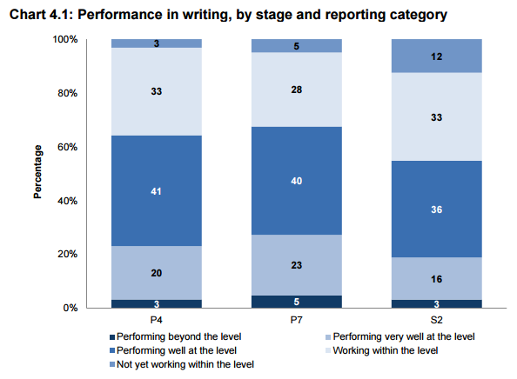
Write with Confidence
Literacy
Toolkit
Activity 2: How’s it going?
SSLN Results: Writing Attainment 2014
64% of pupils at P4, 68% of pupils at P7 and 55% of the pupils at S2 performed well, very well or beyond the level for their stage in writing.
This means more than 1/3 didn’t . . .
What are the possible factors that may contribute to this?
Notes:
The Scottish Summary of Literacy and Numeracy (SSLN) 2012 found, with regards to writing, that 64% of pupils at P4, 68% of pupils at P7 and 55% of the pupils at S2 performed well, very well or beyond the level for their stage.
Participants to discuss:
This means more than 1/3 didn’t . . .
What are the possible factors that may contribute to this?
Participants to be given 2 minutes to discuss – facilitator to collect responses.
Some suggestions may include:
“Development: By age 5 – 6 years children know between 5 – 8,000 words before starting to read.
After age 5, children acquire an additional 1,000 word families each year (e.g. dress, dressed, dressing) (Nation, 2001; Grabe, 2009)
The ability to sequence verbally, e.g. narrative structure, grammatical structure and phrase development
A reliance on schematic teaching for writing, lacking a holistic approach – explore the ‘Learning and Teaching – A Focus on Writing’ PP in The Literacy Toolkit - http://highlandliteracy.com/literacy-toolkit/learning-and-teaching-a-focus-on-writing/
Absence of progression both within and through Levels – see Education Scotland and Highland progression materials
http://www.educationscotland.gov.uk/Images/LiteracyandEnglishGrid_tcm4-830976.pdf
https://highlandliteracy.files.wordpress.com/2015/03/march2015_steps-to-success-highland-literacy-progression-final.docx
Complexity of skills required when producing a wealth of genres.
5 minutes

Slide 5
Write with Confidence
Literacy
Toolkit
Activity 2: How’s it going?
‘Private’ and ‘Public’ confidence
“Children identified reading aloud and writing as activities requiring ‘public confidence’ and that needed a lot of practice ‘privately’ . . . Before children could develop confidence in their writing, they felt they needed to develop some private confidence and have opportunities to practise writing where their efforts would not be on view to the public via classroom wall displays.”
Kellett,M and Aqsa,D (2007) ‘Children researching links between poverty and literacy’. York: Joseph Rowntree Foundation
Notes:
The following quote comes from an article published by the Joseph Rowntree Foundation in which young people conducted a number research studies to look at learners’ perceptions of literacy.
Facilitator to share the quote with participants and participants to discuss:
What opportunities are you currently providing to develop ‘private’ practice to enhance public confidence in writing?
Facilitator to provide 2 minutes for partner discussion and collect responses.
5 minutes

Slide 6
Write with Confidence
Literacy
Toolkit
Activity 3: New Learning
Public
Low ‘Private Confidence’
High ‘Public Confidence’
High ‘Private Confidence’
High ‘Public Confidence’
Private
Low ‘Private Confidence’
Low ‘Public Confidence’
High ‘Private Confidence’
Low ‘Public Confidence’
Notes:
Facilitators to share:
Learners may have different levels of ‘private’ and ‘public’ confidence when writing independently for enjoyment, writing for the audience of other learners or the teacher, or writing for an audience external to the classroom.
We will now look at each of these in more depth.
2 minutes

Slide 7
Write with Confidence
Literacy
Toolkit
Activity 3: New Learning
Public
Private
Low ‘Private Confidence’
Low ‘Public Confidence’
Sarah
Notes:
Facilitators to share:
Sarah is in your class. During writing tasks she requires support through dialogue and images to stimulate ideas. Across various genres direct support is required to organise and structure her writing. Her technical accuracy is improving in reading and short writing tasks; however, in extended writing pieces these skills are not transferred. She is reluctant to share her writing with others unless it is handwriting tasks which she is happy to share due to having particularly neat handwriting.
How could you support Sarah?
Participants to be given 3 minutes to discuss – feedback collected by facilitator.
Some suggestions may include:
Encourage Reading for Enjoyment using texts that are suitable for Sarah’s ability to stimulate ideas during writing tasks – e.g. Independent IPICK Reading strategy: http://highlandliteracy.com/reading-2/guided-reading/
Create an ethos/environment where ‘free’ writing is promoted – provide learners with time each day to write in any mode/genre for pleasure; this does not need to crystalize into ‘finished pieces’
Provide Sarah with purpose and audience for writing e.g. A fairy tale for children in the Early Years to share with them at story time
Allow Sarah time to plan with her peers to support the ideas process
Develop opportunities for structural writing activities e.g. Slow Writing http://highlandliteracy.com/writing-2/slow-writing/
Use a talk based approach, such as Storymapping.
7 minutes

Slide 8
Write with Confidence
Literacy
Toolkit
Activity 3: New Learning
Public
Marc
Low ‘Private Confidence’
High ‘Public Confidence’
Private
Notes:
Facilitators to share:
Marc is in your class. He is confident with the process of critically analysing a text through discussion as a preparatory task for writing. He’s happy to share his ideas with others across the curriculum; however, struggles to get his ideas onto paper. Marc’s writing lacks organisation and technical accuracy. He’s reluctant to let others analyse his writing, but will happily share the texts he has created verbally.
How could you support Marc?
Participants to be given 3 minutes to discuss – feedback collected by facilitator.
Some suggestions may include:
Develop opportunities for structural writing activities e.g. Slow Writing http://highlandliteracy.com/writing-2/slow-writing/
Provide Marc with direct support when structuring texts, i.e. through structural templates, to allow his ‘public’ creativity to develop on paper
Create a supportive ethos and provide Marc with a ‘writing friend’ to help support the editing process
Create an ethos/environment where ‘free’ writing is promoted – provide learners with time (5 minutes) to write in any mode/genre for pleasure; this does not need to crystalize into ‘finished pieces’ – this time can be used to work directly with Marc on the flow/technical accuracy of a piece
Provide Marc with purpose and audience for writing e.g. a letter to his local councillor
Use a talk based approach, such as Storymapping.
7 minutes

Slide 9
Write with Confidence
Literacy
Toolkit
Activity 3: New Learning
Public
Private
High ‘Private Confidence’
Low ‘Public Confidence’
Aimee
Notes:
Facilitators to share:
Aimee is in your class and an able writer; however, she is reluctant to share her writing with others. She discusses her writing with her teacher and is able to identify her strengths and development needs. When creating texts, in their widest definition, she is eager to keep her work private and does not promote her work to be shared in classroom displays as she is anxious she has made technical inaccuracies. At home she regularly creates stories that she shares with her teacher.
How could you support Aimee?
Participants to be given 3 minutes to discuss – feedback collected by facilitator.
Some suggestions may include:
Create an ethos/environment where ‘free’ writing is promoted – this would allow for Aimee to develop the texts that she creates at home for enjoyment
Provide Aimee with real purpose and audience for writing e.g. A fairy tale for children in the Early Years to share with them at story time
Provide opportunities for Aimee to contribute to Shared Writing opportunities – in a small group or with the whole class
Allow Aimee to work with a ‘writing partner’ to support one another in the editing/reviewing process
Ensure that Aimee is being provided with the opportunity to create a wealth of genres – e.g. presentations, posters, diagrams, blogs
Use a recording device to support Aimee’s writing
Write across the learning environment – not just at a table, e.g. collective writing on a strip of wallpaper that the whole class contribute to.
Definition of text: http://www.educationscotland.gov.uk/images/literacy_english_principles_practice_tcm4-540165.pdf – page 4
7 minutes

Slide 10
Write with Confidence
Literacy
Toolkit
Activity 3: New Learning
Max
Public
High ‘Private Confidence’
High ‘Public Confidence’
Private
Notes:
Facilitators to share:
Max is in your class. He thoroughly enjoys writing fictional texts and has experienced success in genres such as newspaper articles, posters, instructions and blog posts. Max enjoys sharing the books he has read and the films he has watched with others. He’s aware of his strengths and development needs and regularly works with his writing partner to review and edit his writing.
How can you ensure that Max is challenged and remains in this quadrant?
Participants to be given 3 minutes to discuss – feedback collected by facilitator.
Some suggestions may include:
Encourage Max to evaluate the books and films he is watching for enjoyment by creating blog posts about them to share with others – purpose and audience
Ensure that Max is aware of his progress and has clearly identified next steps for improvement
Develop Max’s ability to critically analyse texts and develop opinions in writing based on evidence
Support Max in identifying and collecting relevant evidence to support or contradict a point of view
7 minutes

Slide 11
Write with Confidence
Literacy
Toolkit
Activity 3: New Learning
Public
Low ‘Private Confidence’
High ‘Public Confidence’
High ‘Private Confidence’
High ‘Public Confidence’
Private
Low ‘Private Confidence’
Low ‘Public Confidence’
High ‘Private Confidence’
Low ‘Public Confidence’
Notes:
Each practitioner to be given the blank Private/Public Confidence grid with the headings at the top. Practitioners to place each of their learners into the relevant quadrants with regards to writing confidence and share their findings with a partner.
5 minutes

Slide 12
Write with Confidence
Literacy
Toolkit
Activity 4: Personal Action Planning
Select one of the quadrants that you’re wanting to focus on over the coming weeks.
Identify strategies that you’re going to use with these learners to support/challenge their reading confidence.
Share your action plan with a partner.
Bring back your findings to the next session
Notes:
Using the Personal Action plan sheet each practitioner chooses one quadrant that they’re going to focus on over the coming weeks. Practitioners should identify strategies that they’re going to use to support/challenge these learners.
Activity 4: Personal Action Planning
Have copies of My Personal Action Plan ready to distribute
Pair-share: two minutes sharing your plan with your partner then swap.
Randomly choose two or three teachers to share with the group what their partner is planning.
It may be an idea to identify quadrant support partners – two/three people developing strategies for the same quadrant to provide support.
5 minutes

Slide 13
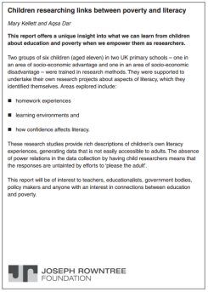

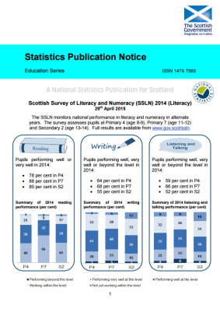

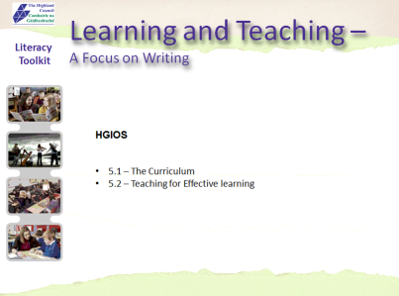
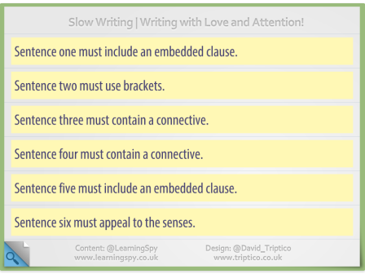
Write with Confidence
Literacy
Toolkit
FOLLOW UP LINKS:
Joseph Rowntree Foundation - Literacy Research | Save the Children - Read On Get On | SSLN (2014) Results
SSLN – Writing Resource | Literacy Toolkit – L&T A Focus on Writing | Slow Writing - Highland Literacy Blog
Notes:
FOLLOW UP LINKS
The facilitator should refer participants to the follow up links which can be accessed independently for further information.

