Slide 1


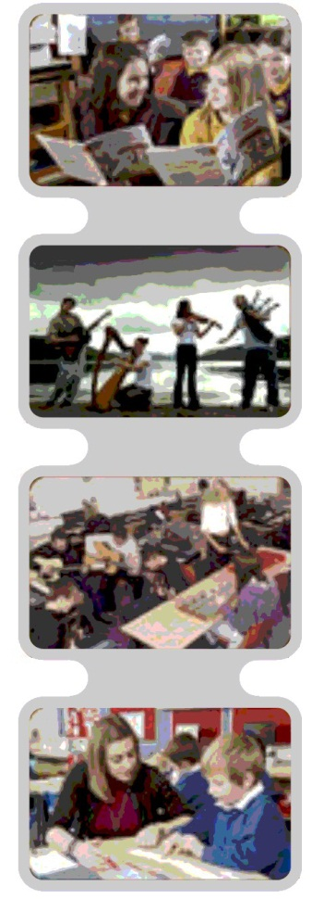
Asking the Right Questions at the Right Time
for School Aged Children
Literacy
Toolkit
HGIOS
Where does it link to How Good is Our School?
1.1 – Improvements in performance
2.1 – Learners’ Experiences
5.2 – Teaching for Effective learning
Notes:
The notes section in each presentation is primarily for the facilitator, indicating additional requirements or information. Please go to the following link for further info.
www.journeytoexcellence.org.uk/about/keydocuments/part3.asp
Asking the right questions at the right time
The objective of this PPT is to explore what types of questions we ask, the developmental nature of verbal reasoning skills and how to adapt our language to achieve improved learning outcomes for children and young people. It is written for education staff working with primary and secondary school ages.
This PPT will address the following Quality Indicators from HGIOS 3
QI 1.1 Improvements in performance
Standards of attainment over time
Overall quality of learner’s achievement
QI 2.1 Learners’ Experiences
The extent to which learners are motivated and actively involved in their own learning and development
QI 5.2 Teaching for effective learning
The learning climate and teaching approaches
Teacher-pupil interaction including learners’ engagement
Clarity and purposefulness of dialogue
Judgements made in the course of teaching

Slide 2
Asking the Right Questions at the Right Time
for School Aged Children
Literacy
Toolkit
Agenda
Activity 1 – Introduction / Starter Activity (5 mins)
Activity 2 – How’s it going / feedback (10-20 mins)
Activity 3 – New Learning (60-70 mins)
Activity 4 – Personal Action Planning (10 mins)
Notes:
This agenda is fixed and is the same for every presentation in the toolkit.

Slide 3
Asking the Right Questions at the Right Time
for School Aged Children
Literacy
Toolkit
Activity 1: Introduction activity
Discuss: Teachers ask an average of one question every minute (Glasson, 2005).
~ Do you think this is too many, too few or just right? Why?
~ What are the advantages and disadvantages of asking questions in the classroom?
Glasson, S. (2005). Hooked on questioning: How the teacher librarian can change questioning practices in their schools.
Following the task, discuss: What did you learn?
Notes:
5 minutes
Facilitator to share:
Teachers ask an average of one question every minute (Glasson, 2005).
~ Do you think this is too many, too few or just right? Why?
~ What are the advantages and disadvantages of asking questions in the classroom?
Glasson, S. (2005). Hooked on questioning: How the teacher librarian can change questioning practices in their schools.
Following discussion, facilitator to share:
Children will not learn by purely being asked questions. They need shared experiences and good adult-child interaction to build vocabulary and develop interaction and communication skills. Questioning can be useful to check a child’s level of understanding or to encourage higher-level language thinking, problem solving and verbal reasoning but it is only a useful teaching tool if the child has been taught / has experience of the original topic in the first place. It is important to be careful with questions and stop to think ‘why am I asking this?’ , ‘can this be taught another way?’.

Slide 4
Asking the Right Questions at the Right Time
Literacy
Toolkit
Activity 2: How’s it going? – what we already know
‘One in five poorer children in Scotland leave primary school unable to read well ( four times higher than for children from the least disadvantaged backgrounds).’
‘Early language skills – listening, understanding words, speaking, and building vocabulary – are the vital foundation that enable children to learn to read.’
‘Currently, children from the most deprived areas are twice as likely to experience difficulties in language development by the time they start school.’
Ready To Read, Closing the gap in early language skills so that every child in Scotland can read well
Discuss: What areas of language development are important when children are learning to read and write?
Notes:
After reading the slide, participants to be given time to discuss. Following this facilitator should collect responses.
Participants to read slide: 2 minutes
Participants to discuss: 5 minutes
Feedback collected: 2 minutes
Suggestions might include:
Understanding / Receptive language
Attention skills
Active listening
Comprehension of single words
Comprehension of abstract concept words
Comprehension of sentences (range of complexity)
Auditory memory
Comprehension of narrative concepts – who, where, what happened, when
Comprehension of higher level language and question words
Interpretation of non-verbal information (such as intonation patterns, gestures, facial expression)
Expressive language
Production of single words
Generation of spoken sentences
Accurate grammatical structures
Generation of narratives (re-telling events in the right order, creating new stories etc)
Facilitator to learners with copies of the Understanding of Language - developmental continuum and the Expressive Language – developmental continuum: http://highlandliteracy.com/emerging-literacy/

Slide 5
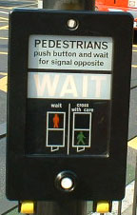
Asking the Right Questions at the Right Time
for School Aged Children
Literacy
Toolkit
Activity 3: New Learning
‘Mrs Smith, why do we have to wait for the green man?’
Discuss: What language skills/knowledge do you need to successfully answer this question?
Notes:
Participants to read slide: 2 minutes
Participants to discuss: 5 minutes
Feedback collected: 2 minutes
Facilitator to share:
Imagine you are walking down the street with a small child. As you wait at the traffic lights the child asks, ‘Mrs Smith, why do we have to wait for the green man?’
What language skills/knowledge do you need to successfully answer this question?
Some suggestions . . . (Facilitator to share)
Auditory memory – you can remember the question you were asked
Single word vocabulary – you understand the meaning of the words
Grammatical knowledge – you understand that it was a question
World knowledge and experience – you know about road safety and traffic lights
Situational understanding – you are aware that you are on a street at the traffic lights
Knowledge / awareness of another person’s point of view / level of understanding – you are aware that the child doesn’t know about pedestrian crossings
Empathy – you understand how the child could be feeling
Implied meaning / inference – you infer that the child is talking about the green man on the pedestrian lights and not a man dressed in a green suit, or a little green man (alien)
Once you have gathered and selected all the information you can then analyse and respond appropriately, this is successful verbal reasoning.
Most adults are pretty good at verbal reasoning, but some children find it very difficult, and like most language skills, verbal reasoning is developmental.

Slide 6
Asking the Right Questions at the Right Time
for School Aged Children
Literacy
Toolkit
The Blank Language Scheme
Devised by Blank, Rose and Berlin (1978)
Encourages development of children’s verbal reasoning and abstract language
Grades language and questions according to complexity
4 different levels that are based on the developmental nature of verbal reasoning
Notes:
Facilitator to share:
The Blank Language Scheme was devised by Blank, Rose and Berlin. They looked at the language demands that teachers place on children and they graded the language and questions according to complexity. They produced 4 levels that are based on the developmental nature of verbal reasoning and abstract language development.
The authors are American but Blank levels are used extensively in Australia and are beginning to become more wide known in the UK.
1 minute

Slide 7

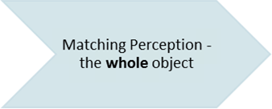
Asking the Right Questions at the Right Time
Literacy
Toolkit
  Name an object - what is this?
  Point to an object - show me the...
  Point to an exact match - find one like this
  name something in the immediate past - what did you see on the table?
Notes:
Facilitator to share:
Level I is the most concrete level
Focuses on the whole object
What the child can see
Objects in the here and now or the immediate past
Use The Gruffalo book as an example:
Page 3-4
What is this? (point to the fox) – a fox
Show me the claws
Show me the mouse
Find one like this (point to a pine cone)
What did the fox do? – ran away
5 minutes

Slide 8
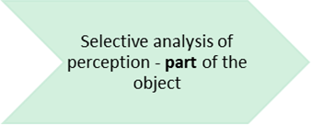
Asking the Right Questions at the Right Time
Literacy
Toolkit
Level II
  finding objects by function - which do we eat with?
  sentence completion - I put my hat on my ....
  naming things that match - what goes with the spade?
  sorting and categorising - what else is a fruit?
  linguistic concepts - find a blue ball, find a small hat
  describe a scene - what is happening in the picture?
  name a difference - what is different about a dog and a horse?
  describe things - who? what? where?
Notes:
Facilitator to share:
Level II – still refers directly to an object but is specific on part of an object
Moving away from the most concrete questions
Still about the ‘here and now’
Use The Gruffalo book as an example:
Page 5-6
What does the owl use to fly?
The mouse is walking on the …..
An owl is a type of bird. Can you think of another bird?
Find a small rock
Find a yellow flower
What is happening in this picture?
What is different about an owl and a dragonfly?
Who is flying?
What is the mouse doing?
Where does the owl live?
5 minutes

Slide 9
Asking the Right Questions at the Right Time
Literacy
Toolkit
Level III
Re-ordering perception - object in its context
  follows a set of directions - put the dog in the box, put the lid on and give it to me
  gives an example with a condition - show me a animal that is not black
  identifies similarities - how are these the same?
  can arrange pictures in a sequence
  tells a story / describes an event - what did you do today in games?
  show theory of mind - what might Mum say? what might Mum feel?
  give a definition - what is a mouse?
  summarise the story in a sentence - what have you done?
  predict - what might happen next?
Notes:
Facilitator to share:
Level III – moving away from concrete perception to abstract thought
Talking about the here and now but also things in the future
Thinking about ideas from other people’s perspective
Looking at the physical object or experience in the context of the child’s pre- existing knowledge
Use The Gruffalo book as an example:
Page 9-10
Point to the snake, the mouse and a leaf
Show me a frog that is not swimming
How are the mouse and the frog the same?
Have you ever been for a walk in the woods? What did you do there? What happened?
What might this frog say to the other frog?
How might the mouse feel?
How might the snake feel?
What is a mushroom?
What has happened in the story so far?
What might happen next? (it’s only prediction if the child doesn’t know the story)
8 minutes

Slide 10
Asking the Right Questions at the Right Time
Literacy
Toolkit
Level IV
complex and abstract verbal problems - the relationships between objects, people, events and reasons
  justify a problem - why will the boat float?
  identify the cause - what made the boy cry?
  solve a problem - what could you do if you didn't have your lunch?
  solve a problem from another person's perspective - what could Mrs Smith do if she didn't have any paper?
  Make an inference from an observation - how can we tell that this book is old?
  explain why something cannot be done - why can't penguins fly?
  select a means to a goal - what do we need to make Mother’s Day card?
  explain the logic of compound words - why is this called a newspaper?
Notes:
Facilitator to share:
Level IV – thinking about abstract concepts and drawing on knowledge and experiences that are not specifically related to the ‘here and now’
Questions involving higher level problem solving and explanation
Use The Gruffalo book as an example:
Why does the Gruffalo want to eat the mouse?
What made the fox run away from the mouse at the end of the book?
What would you do if you met a Gruffalo?
What do you think Mrs Smith would do if she met a Gruffalo? How could she avoid being eaten?
How can we tell that it’s daytime in this story? What does the mouse in this story like to eat?
Why cant the mouse fight the Gruffalo?
Let’s act out the story – what do we need?
8 minutes

Slide 11

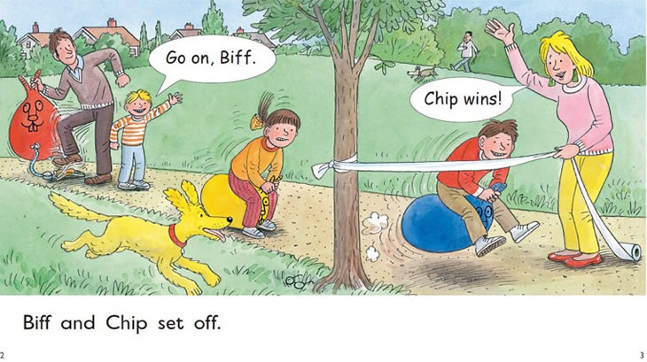
Asking the Right Questions at the Right Time
Literacy
Toolkit
Now it’s your turn to try!
Notes:
Participants to complete task: 12 minutes
Feedback collected: 4 minutes
Provide learners with a copy of The Blank Language Scheme handout
Either provide or have asked learners to bring a book from their classroom (fiction or non-fiction is fine)
Facilitator to share:
Now its your turn to think about questions
Learners to get into pairs or small groups (no more than 4 in a group)
Turn to a page and take turns thinking of a question at each Blank level…..(or, alternatively – one person asks a question and the others grade it on the Blank Language Scheme levels)
Try to generate a range of questions for all levels
You have 15minutes
Reflection questions – Facilitator to share and collect responses:
How easy was it to generate the full range of questions?
Was one level easier than any of the others to think about?
What type of response would you expect if a child was functioning at a lower level than the question asked?

Slide 12
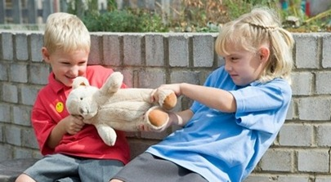
Asking the Right Questions at the Right Time
Literacy
Toolkit
Using Blank levels to support behaviour
What happened?
Who does the teddy belong to?
How is Joshua feeling? Why is he feeling x?
What should you say to Joshua now?
How can you do things differently next time?
If you wanted to borrow Joshua’s teddy, what could you have said?
What would you have done / how would you have felt if somebody grabbed your teddy?
So, what do you need to do now?
Notes:
Participants to read slide: 1 minute
Participants to discuss: 10 minutes
Feedback collected: 4 minutes
Facilitator to share:
Can Blank Levels help us with behavioural management?
Look at these questions. These are all questions that are typical when there has been a behavioural incident in the playground.
In pairs or small groups, think about:
Where do they rate on the Blank Levels?
Why would a child have difficulty with these types of questions and therefore struggle to learn about behavioural expectations?
Can you think of an alternative question or comment to ask instead of the Level III and IV questions?
Discuss – Can you think of any types of children that would be later to develop ability at Level III and IV? (or not at all?)
Possible discussions:
Children with language impairment
ASD
Social communication difficulties
Attachment?
Children with learning difficulties
Children with limited stimulation from a young age – e.g. looked after children
Underlying medical condition – e.g. Foetal Alcohol Spectrum Disorder

Slide 13
Asking the Right Questions at the Right Time
Literacy
Toolkit
Activity 4: Personal Action Planning
Select one curriculum or topic area to focus on over the next month – e.g. literacy, numeracy, in the playground, circle time etc.
Think about how you will adjust your questioning to the ‘right level’ – how will you know what level is ‘right’?
Share your action plan with a partner.
Bring back your findings to the next session
Notes:
Using the Personal Action plan sheet each teacher chooses one curriculum area to focus on over the next month. Think about the different blank levels – how will you adjust your questioning?
This may involve doing more of some things and less of others and teachers may need pushing on this.
Activity 4: Personal Action Planning
Have copies of My Personal Action Plan ready to distribute
Pair-share: two minutes sharing your plan with your partner then swap.
Randomly choose two or three practitioners to share with the group what their partner is planning.
5 minutes

Slide 14




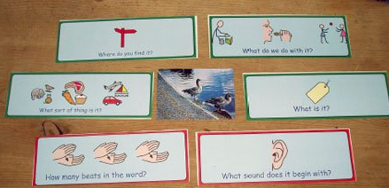


Asking the Right Questions at the Right Time
Literacy
Toolkit
FOLLOW UP LINKS:
Ready to Read Scotland | Read on Get on - Scotland | RALLI Campaign - YouTube
Building Vocabulary for Better Literacy - Highland Literacy | The Communication Trust | Highland Literacy - Emerging Literacy
Notes:
FOLLOW UP LINKS
The facilitator should refer participants to the follow up links which can be accessed independently for further information.

