Slide 1

Early Reading and Writing
How can you support your child as they develop their reading and writing skills?
Notes:
This resource has been created to support practitioners when working with their families within their school community. The resource is intended to support the introduction of the Emerging Literacy materials, supporting schools and their families to take a developmental approach to Literacy.
This resource introduces how families can support their child’s development within the four developmental continua; Concepts of Print, Phonological Awareness, Oral Language and Fine Motor Skills. This resource, in its entirety, will take around 1 hour to deliver; however, practitioners may wish to focus on specific aspects of the resource.
The structure is as follows:
Introduction to Developmental Approaches (20 mins – approx.)
Phonological Awareness – family support ideas (10 mins – approx.)
Oral Language – family support ideas (10 mins – approx.)
Fine Motor Skills – family support ideas (10 mins – approx.)
Concepts of Print – family support ideas (10 mins – approx.)
Optional opportunity for practitioners to share how early reading and writing development looks in their classroom, or to share the operational structure within their environment (10 mins – approx.)
In this slide, the facilitator should share the purpose of the session, e.g.
‘Good morning/ afternoon/ evening, thank you for coming along. This morning’s/ afternoon’s/ evening’s session is going to look at how we can work together to support your child to develop their reading and writing skills.’

Slide 2
Let’s start with an easy task . . .
Notes:
Participants should be provided with a pen and paper.
The facilitator should share:
‘Now you’re comfortable, let’s begin with an easy task. For this task you will need a pen/ pencil and paper. I’m going to say a sentence. I would like you to write the sentence that I say’.
It is raining today. <pause and wait> It is raining today.’

Slide 3
Was that an easy task?
  What did you have to be able to do in order to do that?
    Knowledge
    Skills
    Other things?
Notes:
The facilitator should share:
‘I said that was an easy task, but I want you to think – Was that an easy task? Before you were able to write the sentence, what were some of the things that you needed to know or be able to do before you could complete that task?’
The facilitator should provide time for people to think/ write down/ discuss the different things that they needed to know or be able to do before they were able to do that task. Once they have had time to reflect, the facilitator should ask for answers to be shared and note these down.
Some suggested answers:
Know to write from left to write
Know what each of the letters look like
Know the sounds which make up each of the words
Hear the individual words within the sentence
Listen to and recall the words within the sentence
Understand the meaning of the words within the sentence
Can follow the instructions to complete the activity
Hold the pen correctly
Form the letters correctly

Slide 4
Concepts of Print
Phonological Awareness
Oral Language
Fine Motor Skills
Notes:
The facilitator should share:
‘When we teach reading and writing skills, the majority of these are able to fit into one of these four boxes. For example:
Concepts of Print might include:
Know to write from left to write
Know what each of the letters look like
Phonological Awareness might include:
Know the sounds which make up each of the words
Hear the individual words within the sentence
Listen to and recall the words within the sentence
Oral Language might include:
Understand the meaning of the words within the sentence
Can follow the instructions to complete the activity
Fine Motor Skills might include:
Hold the pen correctly
Form the letters correctly

Slide 5
It is easy if:
Many different skills
  Co-ordinated
  In the right order
  Automated
Notes:
The facilitator should share:
‘As adults, many of us have the developed skills to complete that task. That task, however, is only easy if all of the different skills which we have mentioned are co-ordinated, they are in the right order and they are automated’.

Slide 6
Automated?
With the person next to you:
  If you drive, what was it like the first time you drove a car?
  How is that different to now?
Notes:
The facilitator to share:
‘Let me try and share what I mean by automated. With the people next to you, I want you to reflect: If you drive, what was it like the first time you drove a car?’
<facilitator to provide time to share>
‘Perhaps the first time you drove you couldn’t remember what to do with your left foot, or perhaps you struggled to recall the difference between the window wipers and the indicators. How is that first experience different to now?’
<facilitator to provide time to share>
‘Perhaps now you’re able to drive and at the same time have a conversation with someone in the passenger seat. Perhaps now when it rains you reach for the window wiper instinctively.’

Slide 7
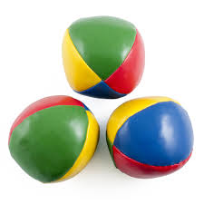
Notes:
The facilitator to share:
‘So, let’s put your skills to the test. If I was to give you three juggling balls, how much time would it take for you to confidently stand up and juggle these in the room?’
<facilitator to encourage participants to share amounts>
Okay, so you said it would take you ___ to learn how to juggle the juggling balls, what if I asked you to juggle these?’ <facilitator to click next slide>

Slide 8

Notes:
<facilitator to pause for reaction and then click the next slide>

Slide 9
Possible behavioural reactions
Not doing it!
Only trying one or two (or not so high)
Just bashing on
Notes:
The facilitator to share:
‘Some of you may have thought – I’m not doing this at all! Some of you may have given it a go; however, only tried with one vase or two vases, keeping them close to your chest. And some of you may’ve bashed on regardless, resulting in a situation where you would either have pulled it off or most likely had to fetch the dust pan and shovel’.

Slide 10
Automated skills
Takes practice for skills to become automatic
Effortless
Does not use “capacity”
  Room to think about other things
Suppose a child has to think effortfully about:
  Holding a pencil
  Spacing, or going from left to right
  Where one word ends or another begins
Notes:
The facilitator should share:
‘So, when children are reading and writing we want this to become effortless. Imagine your child has to think about how to hold the pencil, the spacing in between words, going from left to right and thinking about where one word ends and another begins – what room does your child have left to share their ideas?’

Slide 11
Similar for reading?
Notes:
The facilitator to share:
‘We know this is the case for writing, but is it the same for reading?’

Slide 12
Forgetting how to read
Not as easy as it seems . . .
Mo st pe ople c an rea d t h is
No rdo est hisg ive ma nypr obl ems
Xvxn xf yxx txkx xxt lxttxrs
Notes:
The facilitator to share:
‘Most people can read this; nor does this give many problems; even if you take out letters’.

Slide 13
Very important message:
Don’t read this!
Notes:
The facilitator to share:
‘I’ve got an extremely important message that I want to share with you. You need to try your hardest to follow this message.’
<The facilitator should click again which will bring up the message ‘Don’t read this!’>
‘Perhaps that was also a difficult task; particularly for someone with automated reading skills’.

Slide 14

What was it like at first?
&%* &~#£ #$ *ou &~#nk %>ad#ng #£ >a£*
Notes:
The facilitator to share:
‘Okay, perhaps this is a little more like what reading was like for you when you first started to learn to read. I’d like you to use your reading skills to work out this sentence. All of the letters have been substituted for a symbol.’
<facilitator to provide time for participants to work this out – participants to be encouraged to call out words when they see them>
<The sentence is: Try this if you think reading is easy.>
<facilitator may wish to encourage participants to share what made certain words easier to identify>

Slide 15
בבְּרֵאשִׁיתתבָּרָ֣אאֱלֹהִ֑יםאֵ֥ת
הַשָּׁמַ֖יִםוְאֵ֥תהָאָֽרֶץ׃
Notes:
The facilitator to share:
‘Okay, that perhaps wasn’t the fairest of examples. Many of us as adults will have the skills to attack a task like this. Let’s try something a little bit different. How about this example; what makes this tricky to read?’
<allow participants to share examples>
‘Something which makes this difficult is that you might not recognise the letters. I know, I’ll give you a rapid paced phonics programme which will help you identify each of the letters within the English language.’
<facilitator to click to next slide>

Slide 16
ahtemiholearabtisereb
steraahteevmiyamahs
Notes:
The facilitator to share:
‘You’ve had your phonics programme, what is making it difficult to read now?’
<facilitator to provide time to share>
‘You may have noticed that there are no spaces between the words – you do not know where one word ends and another begins. Let me add the space in-between words.’
<facilitator to click on to next slide>

Slide 17
ah te mihole arab tisereb
steraah te ev miyamahs
Notes:
The facilitator to share:
‘Now I’ve added the word boundaries, there are perhaps some things which might still make this difficult. One of these is that the words may not be in your vocabulary – understandably so, this is Hebrew. For those of you that started to sound these words out from left to right, you would also be down the wrong track as Hebrew runs from right to left’.

Slide 18
Phonological Awareness
Oral Language
Fine Motor Skills
Concepts of Print
Notes:
The facilitator should share:
‘When designing our literacy programme, we want to ensure that your child further develops their pre-reading and pre-writing skills, alongside developing an awareness of phonics and mark making. We aim to take a developmental approach so your child is secure within their pre-reading and pre-writing skills. It has been found by doing this that we can decrease the number of children who require additional support in reading and writing as they move through the school. We want to build reading and writing skills on strong foundations.
The remainder of this session is going to look at how you can support your child’s concepts of print, their phonological awareness, their oral language and their fine motor skills at home.’

Slide 19

Rhyme
Little Miss Muffet,
Sat on a tuffet,
Eating her curds and whey,
Along came a spider,
And sat down beside her,
Scaring Miss Muffet away
Phonological Awareness
Notes:
Phonological Awareness (10 mins approx.)
Facilitator to share:
‘When developing phonological awareness skills, we will develop a number of skills including your child’s ability to listen to instructions, their ability to hear and produce rhyme, their awareness of the syllables within words and their awareness of the sounds within words.
At home, one way you can support your child’s phonological awareness is through developing their rhyming skills. This can be developed through:
Sharing nursery rhymes
Reading rhyming books
Making up rhymes together
Supporting your child in creating rhyming words’
Facilitator can provide a selection of nursery rhymes and rhyming books for families to look at. Facilitators may also wish to make some of the Rhyme Awareness and Rhyme Production activities (available on the Highland Literacy Blog within the Phonological Awareness continuum) available for families to try.
Phonological Awareness page: http://highlandliteracy.com/emerging-literacy/phonological-awareness/

Slide 20

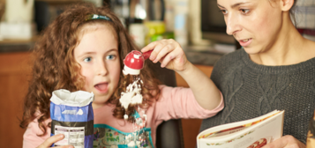
Playing with your child for ten minutes a day will support the development of your child’s oral language.
Oral Language
Notes:
Oral Language (10 mins approx.)
Facilitator to share:
‘When you are talking to someone, what are some of the things that people do when they’re not giving you their full attention?’
<facilitator to provide time to discuss and then collect feedback>
Some suggestions may include:
No eye-contact
Distracted by a phone/ TV/ computer etc.
Listening to another conversation
Talking over you when you are talking
Showing no interest in what you’re saying
Facilitator to share:
‘In comparison, when you’re talking with someone, what things do they do to show you that they are giving you their full attention?’
<facilitator to provide time to discuss and then collect feedback>
Some suggestions may include:
Giving you eye-contact
Sitting close to you
Turning off a phone/ TV/ computer etc.
Finding a quiet space to talk
Allowing you to finish before they talk
Showing that they’re interested by smiling and nodding
Facilitator to share:
‘So, when you’re playing with your child, what are some of the things you do to ensure that they have your full attention?’
<facilitator to provide time to discuss and then collect feedback>
Some suggestions may include:
Playing beside them
Giving them eye-contact
Turning off a phone/ TV/ computer etc.
Finding a quiet space
Allowing them to finish before you talk
Showing that you’re interested by smiling and nodding
Facilitator to share:
‘It is important that all of these things are in place to support your child’s language development. You will support your child’s language through allowing them to hear and use familiar and new words within different activities. Playing alongside your child for ten minutes a day will support the development of your child’s oral language’.

Slide 21
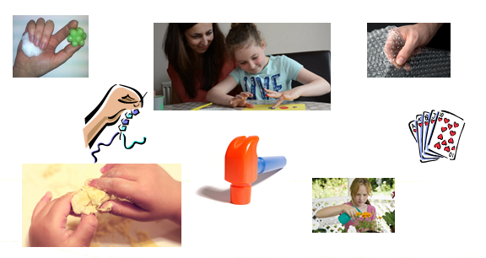
Fine Motor Skills
Notes:
Fine Motor Skills (10 mins approx.)
Facilitator to share:
‘In school we aim to support your child in developing big movements, known as gross motor skills, through indoor and outdoor physical and play activities. We also aim to aim to support your child’s small movements, known as fine motor skills through a number of fine motor, scissor and pre-handwriting activities.
Some things which you may do at home to support your child are:
Provide them with opportunities to use scissors to cut out shapes and patterns
Provide them with big paper and drawing implements
Allow them to make marks outside with paint brushes and water or large chalks
Create a chain with pasta and a shoe lace
Create objects using dough
Make finger puppets
Put coins into a money box
Turn a deck of cards over as quickly as they can
Hammering
Squeezing bubble wrap
Playing with wind-up toys
The facilitator should have example resources (as detailed above; including any other relevant fine motor resources) available. Facilitators may also wish to provide families with the Fine Motor Skills activities from the Pre-Handwriting page (you could focus on pg.9) on the Highland Literacy Blog.
Pre-Handwriting page: http://highlandliteracy.com/emerging-literacy/pre-handwriting/
Fine Motor Skills support: https://highlandliteracy.files.wordpress.com/2015/12/play-fine-motor-skills.pdf

Slide 22



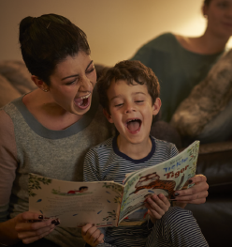
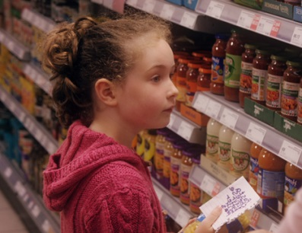
www.readwritecount.scot
Concepts
of Print
Notes:
Concepts of Print (10 mins approx.)
The facilitator should have a number of different picture books available for families to look through.
Facilitator to share:
‘To develop your child’s awareness of print, it is recommended that you read to your child every day. You may read lots of different stories or you may read their favourite story again and again. Reading with your child for ten minutes each day will have a positive impact on their awareness of print. When reading with your child, sit beside them, allow them to see the pages and point out the pictures, modelling the reading process.’
<Facilitators may also wish to share the ‘Improving Literacy with Parental Involvement’ resource if they’re school offers this as a programme for families>
Improving Literacy with Parental Involvement: http://highlandliteracy.com/improving-literacy-with-parental-involvement/
Facilitator to share:
‘When out and about, point out food labels, road signs and shop signs. Become a member of Highland Libraries – whether that be through visiting the library or the library bus’.
<Facilitators may also wish to mention the Libraries ‘Book Bug’ scheme which provides books for children in the Early Years and in Primary 1. There are also family sessions available – for information, contact your local Network Librarian>
Facilitators to allow families to look through some of the picture books which are available.
Facilitator to share:
‘The Scottish Government’s Read, Write, Count website has practical suggestions that families can use to support their child’s emerging literacy and numeracy skills’.
Read, Write, Count: http://www.readwritecount.scot/

Slide 23
Notes:
<This slide is optional for practitioners to share how early reading and writing skill development looks in their classroom, or to share the operational structure within their environment>.

