Slide 1

Paired Reading
Our thanks go to Professor Keith Topping

Slide 2
HIGIOS
Leadership of Reading
Linked to HGIOS 4: Q.I. 1.2 – Leadership of Learning
Learning, teaching and assessment of Reading
Linked to HGIOS 4: Q.I. 2.2 – Curriculum; Q.I. 2.3 – Learning, teaching and assessment; Q.I. 2.4 – Personal Support
Family Engagement
Linked to HGIOS 4: Q.I. 2.5 – Family Learning
Transitions in Learning
Linked to HGIOS 4: Q.I. 2.6 – Transitions
Equity and Excellence
Linked to HGIOS 4: Q.I. 3.2 – Raising attainment and achievement

Slide 3
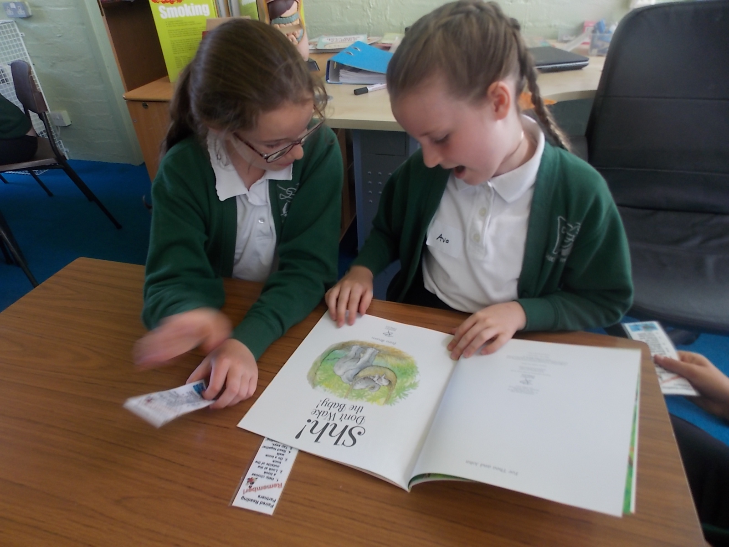
What is Paired Reading?
Paired reading is a very effective, evidence-based method of helping children progress in their reading developed by Keith Topping.

Slide 4
What is Paired Reading?
Paired reading is a way that you can help others enjoy reading and for them to know that even when it is difficult, they CAN do it!

Slide 5
Why do we learn anything?

Slide 6





Some ideas of what might make you want to learn
So you know how to do something
01
So you can feel good about yourself
02
So you can help others
03
So you can enjoy activities
04
So you can get a good job
05

Slide 7
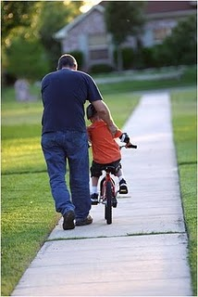
Holding on…..and letting go!
It is like a child learning to ride a bike. In the early stages you give the child encouragement, confidence and control, by holding the bicycle. Your own instinct will tell you when to let go. So you can gradually disengage for longer periods until your child is able to ride without help.

Slide 8
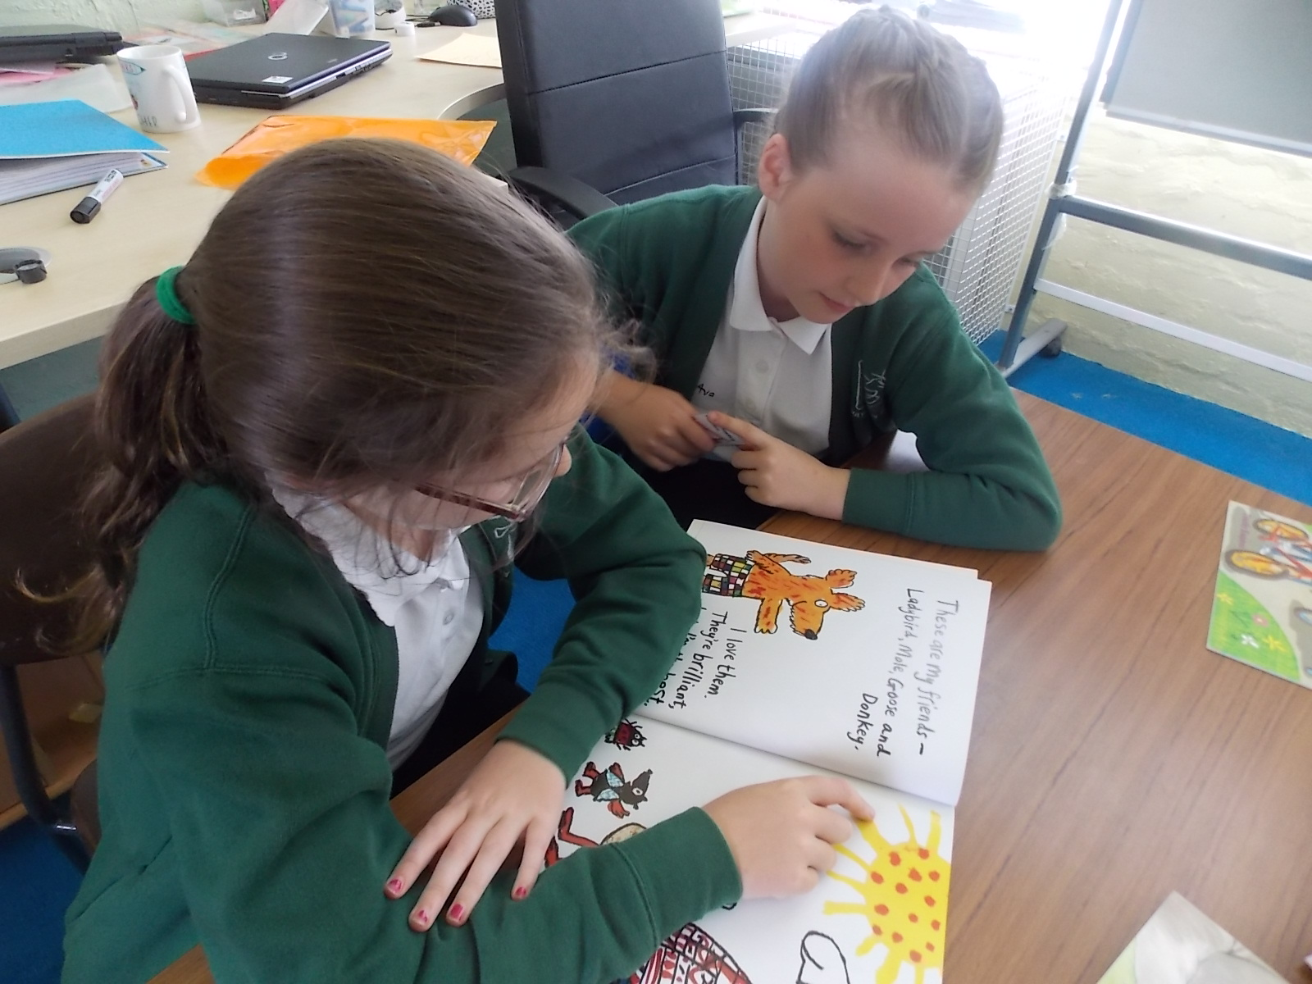
The same applies to Paired Reading. It is an ideal way of helping your child to become an independent reader. It works on building up the positives and successes rather than concentrating on mistakes.

Slide 9
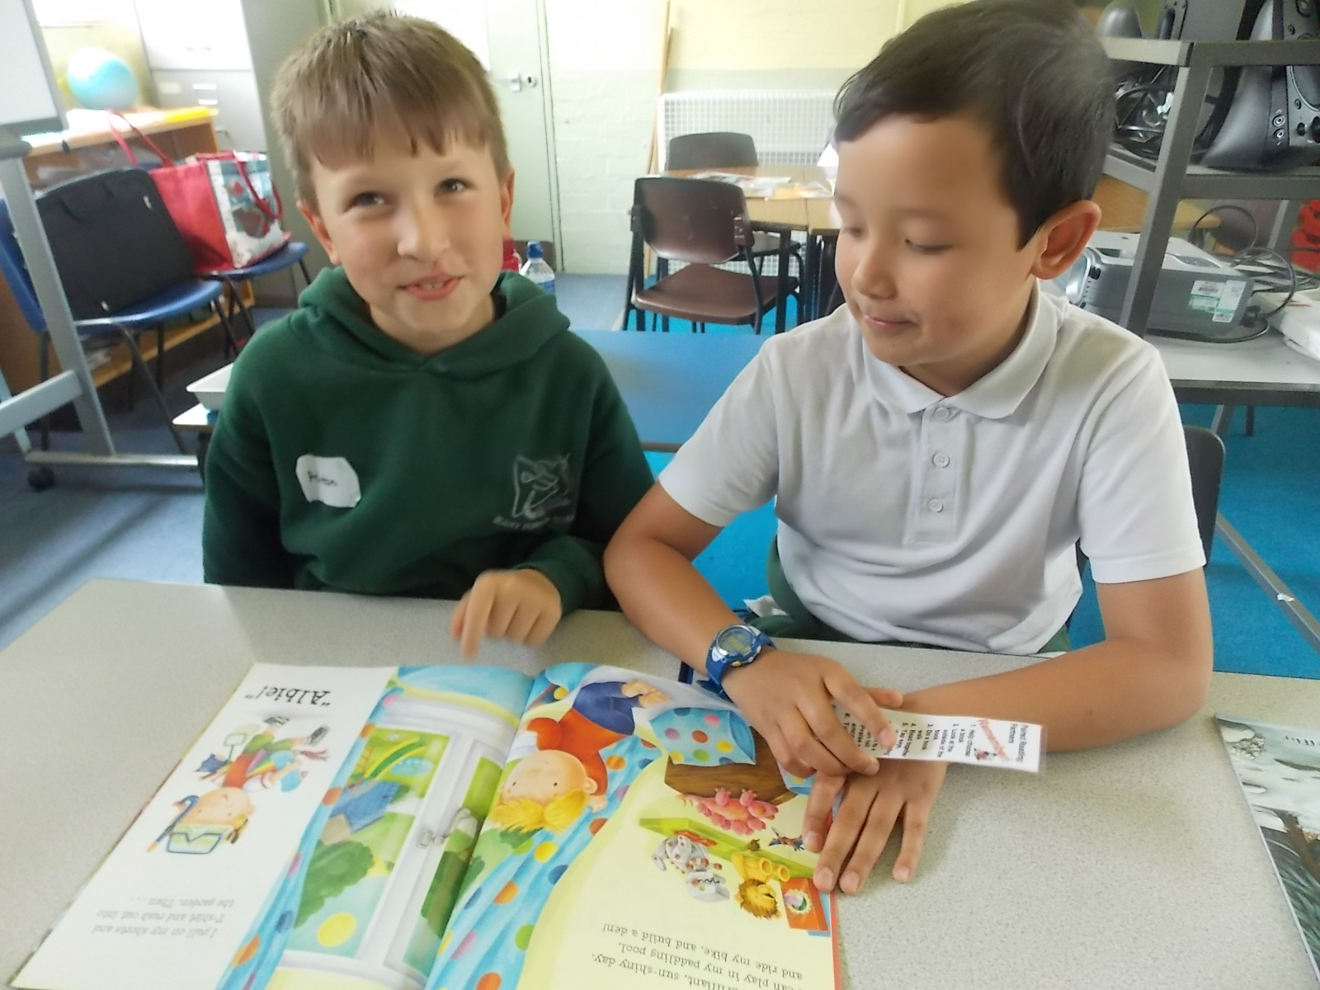
It helps to:
Develop a child’s love for reading and books
Encourage a child to read independently with confidence
Build up trust between the reader and reading partner

Slide 10

Cloaked with emotion
How did you feel when you first learnt to ride a bike?
What was your best present. How did you feel?
Have you every had the whole class laugh at you? How did you feel?

Slide 11
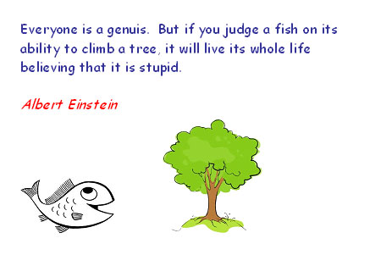
We are all good at different things. Being a good reader doesn’t make you better than someone who struggles with reading.

Slide 12
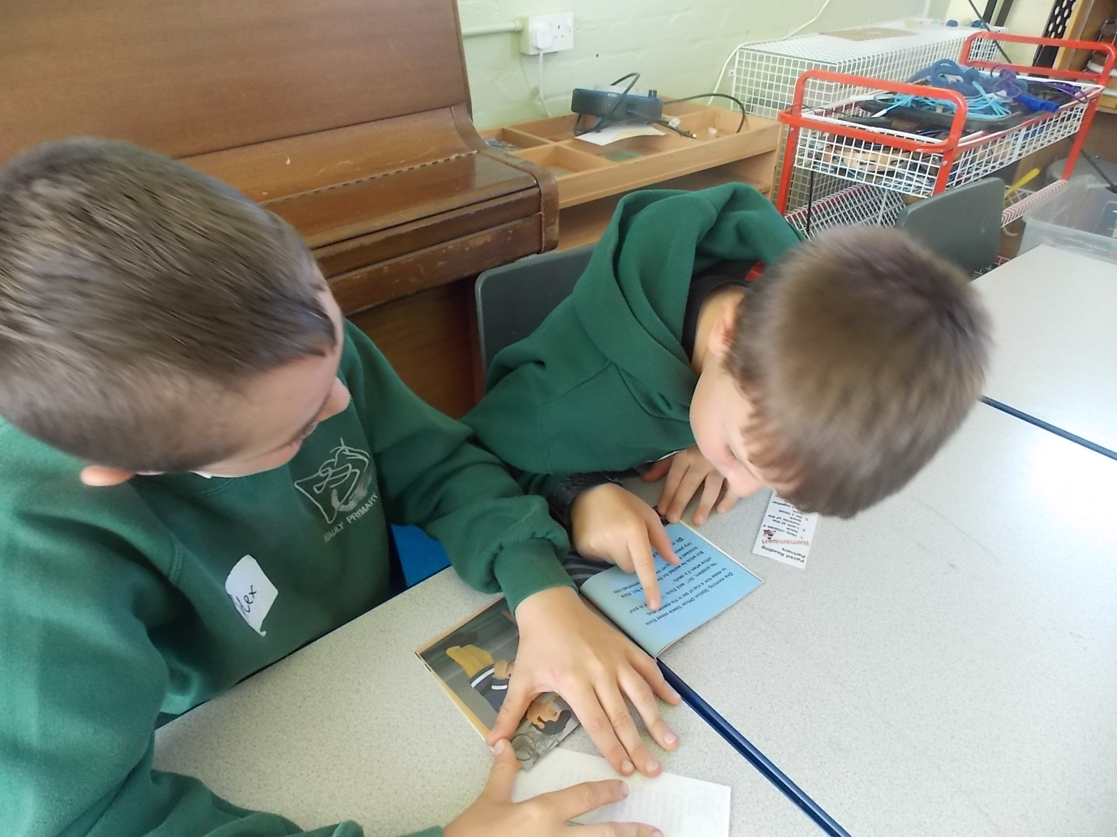
Who is Paired Reading for?
Paired Reading works best for children who have already made a start with reading. For those in the first stages of developing literacy. It is also very effective with older struggling or reluctant readers. Every child will benefit from using Paired Reading. It is not just for children with learning difficulties.

Slide 13
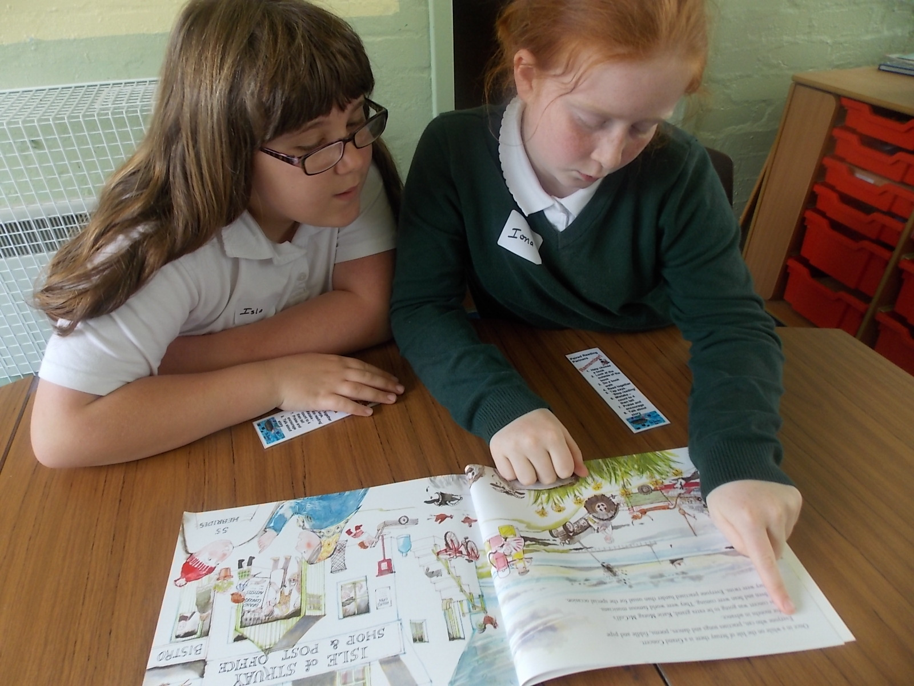
Who is involved?
Paired reading can be carried out using a number of different partnerships.
Teacher and pupil
Parent and child
More advanced peer and skill developing child

Slide 14
What are the benefits?
Parents who have undertaken Paired Reading, report that not only does the child's reading improve but that child's self-esteem has improved, and generally the child is more co-operative at home also. This can be attributed to the quality parent - child relationship that develops as they spend more time together.

Slide 15
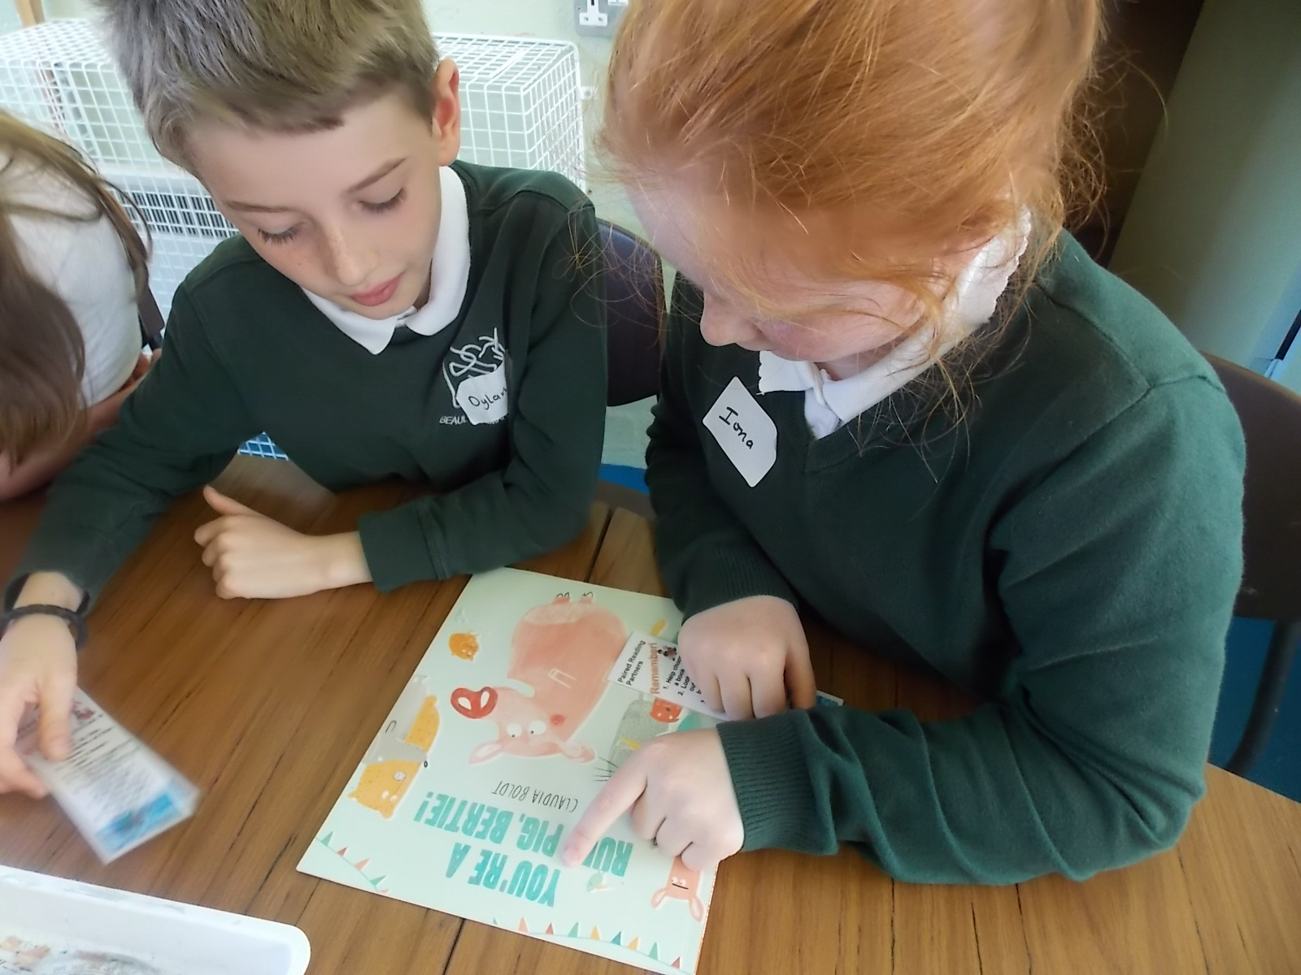
Children who have taken part in paired reading sessions, comment on their developing enjoyment of reading and no longer dreading reading lessons.
Teachers often notice a marked difference in a child’s reading fluency, confidence and enjoyment in reading.

Slide 16
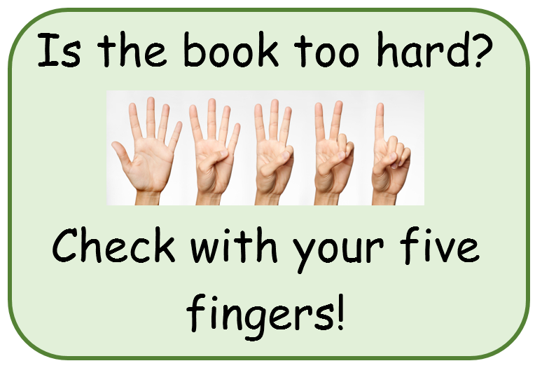
What reading materials should we use?
Any type of text could be used from story books and comics to recipes and leaflets. The child should choose the text. The chosen text should have around four new words to a page – enough to enable progress but not so many to make the child feel overwhelmed.

Slide 17
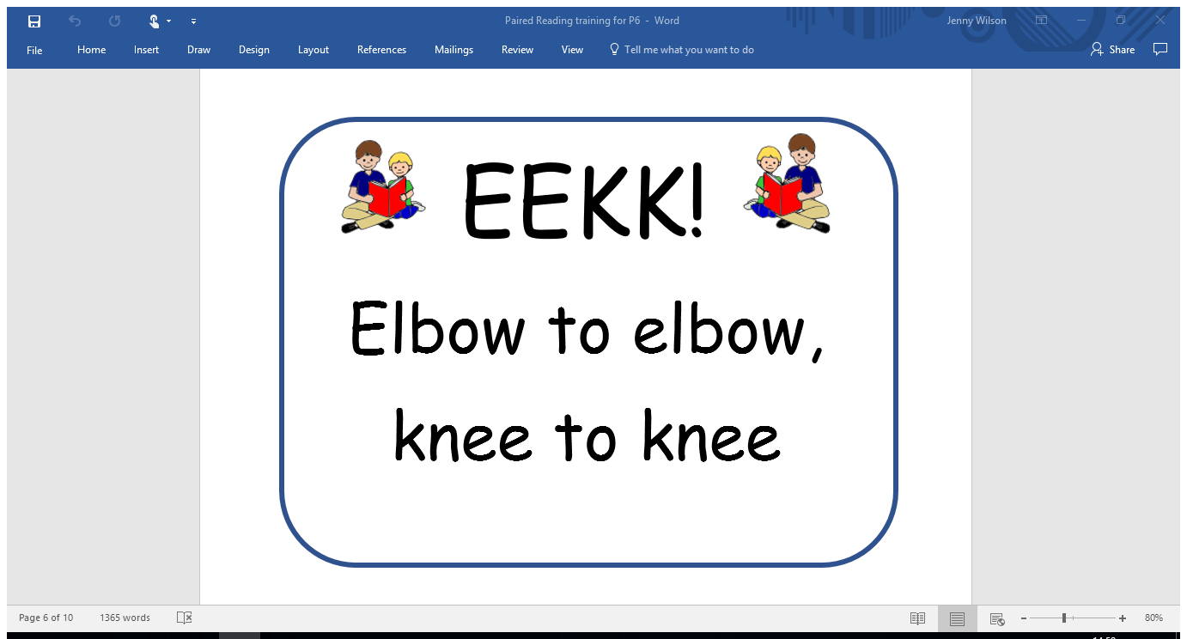
How often should Paired Reading be carried out?
As often as possible but at least three times a week for 15 to 20 minutes. The time can be adjusted according to the child’s needs and abilities.

Slide 18
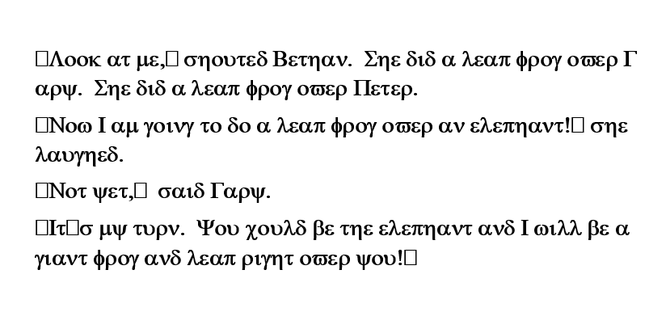
What does it feel like to be a new reader?

Slide 19
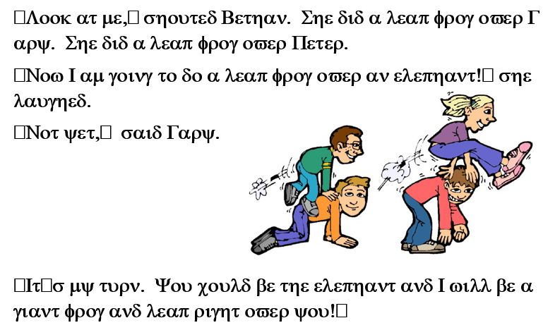
Does this help?

Slide 20
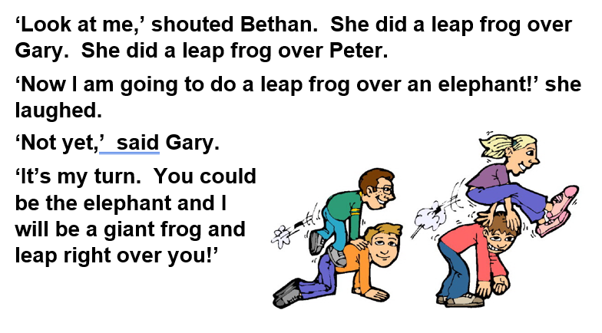
How did you do?

Slide 21

How does a Paired Reading session work?
Make sure you are comfortable. Turn off the television and minimise distractions.
Let the child choose the book to read.
Together look at the outside of the book: the picture, the title, and the author. Talk about what these might be telling us about the book.
Take a ‘picture walk’ through the book, talking about the things you see, what might happen on the next page, ask open questions and acknowledge and praise answers. Give any thinking time that is necessary.

Slide 22
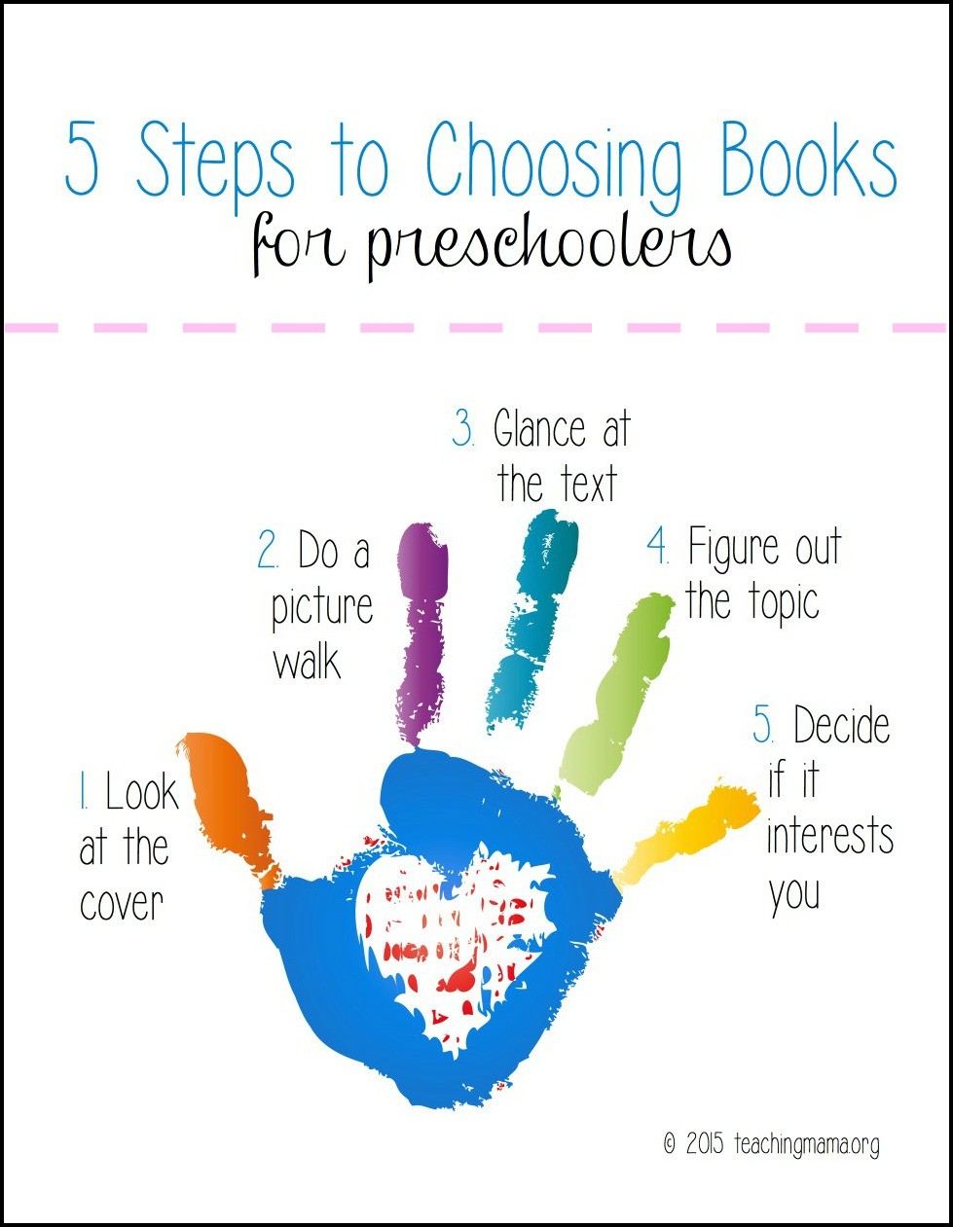
Choosing the right book
Is it one they will enjoy?
Look at the pictures and read the title to see if it is about something they like hearing about or something that they want to learn about.

Slide 23


The learner should be in control of the book: turning the pages, pointing to the words, setting the pace.
For some children, you will need to read the story first. Have the child point to the picture and you read only when he/she has pointed to the next word.
For most, begin by reading together. The child is in charge of pace by moving his/her finger along the text, so you may have to read slower than you would like to begin with. If the child wishes to read alone, they tap the book (or other agreed symbol) and you stop reading.
I’m the Book Boss!

Slide 24
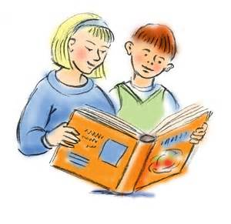
Then it is his turn to read if he wishes to. It may take several readings together over subsequent days to build a child’s confidence up sufficiently to read aloud alone. Again he should point to the words as he reads. The child’s voice should dominate the sessions.
Make audible sounds of affirmation regularly (changing words you use and sounds you make) especially at any difficult words which were read correctly or when the child has self-corrected mistakes.

Slide 25

Praise often
Quietly praise often while your partner is reading. You don’t want your voice to dominate the story, just a quiet reassurance they are doing well.

Slide 26
When the child gets stuck
If the child gets stuck, allow about 4 to 5 seconds for him/her to work it out.
If the child can’t work it out in that time, they probably won’t be able to. Don’t make a fuss or show displeasure but tell them the word and show how you know what it says using techniques such as sounding it out and breaking it up.
Then, begin reading with the child again until the child taps the book again (or other agreed sign).

Slide 27
Wait before you correct!
She is stuck on a word. I’ll count to 4 and then help her.
If your reading partner makes a mistake, don’t tell him the correct word straight away.
Count in your head to 4, then tell him what it says. Tell him how you know what it says.

Slide 28

Sometimes you need to tell them that it is a silly word and they just have to learn it. Write the word down and practice it later, maybe looking for it again on another page. Remember this is to be a time of positives and not negatives. Praise the child for listening. Say, ‘I can tell you are concentrating on this difficult word because you are looking at the word, you are listening to me, your hands and feet are still’.

Slide 29
Pause in the reading every now and again to talk about what has been read, anything funny that has happened, how it could relate to the child’s own experience, or to ask questions.

Slide 30
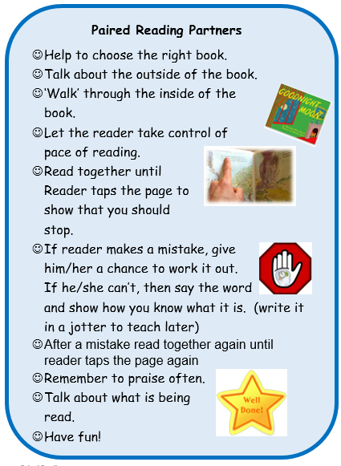

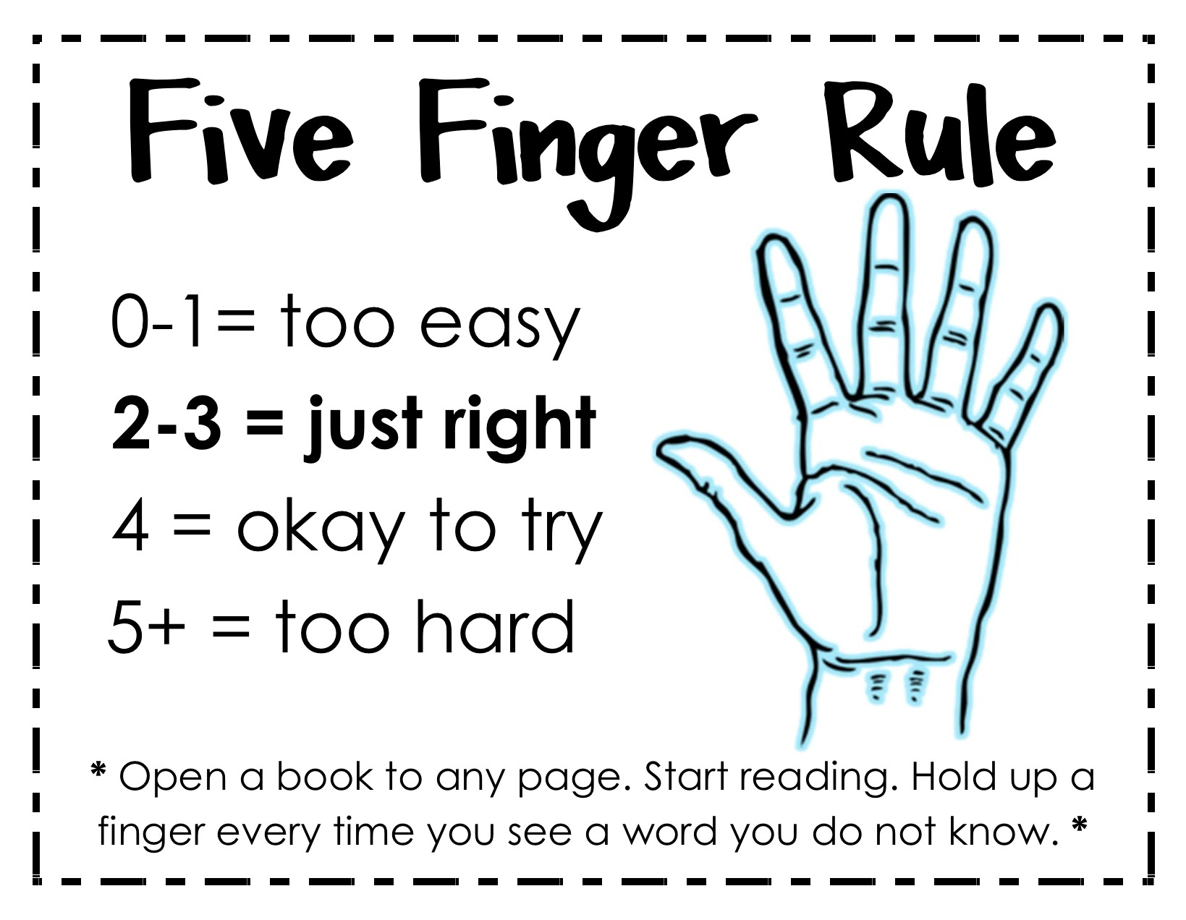


Slide 31
Let’s have a go!
Remember:
EEKK
Read until the TAP signal
Count to 4 then tell the new word
Praise often
He is stuck on a word. I’ll count to 4 and then help him.

Slide 32
I hope you have fun and enjoy this special time together.

