Slide 1

Wraparound Spelling
Wraparound Spelling
Foundations and interventions
For 1st and 2nd Level

Slide 2
What was this child trying to write?
metantatipy

Slide 3
 What stage was this speller at?
'logographic' stage
Memorises the spelling of whole words
Early Level
(age 5 or 6)
'alphabetic' stage
phonic awareness and growing understanding of the phoneme/grapheme relationship
First Level
(age 6-7)
'orthographic' stage
Abstract code awareness bringing a higher level of understanding of the different ways in which phonemes can be written
Second Level
(from about 8)
Metantatipy
Meat and tattie pie
What might he not understand?
In this case, why would this be understandable?

Slide 4
Spelling is a vital component of reading.
For young children, spelling supports learning to read.
For older children, the meaningful relationships between words will contribute to vocabulary growth and reading comprehension.
Writing
Reading
spelling

Slide 5
Spelling is an essential and complex skill involving multiple components, including visual memory, phoneme-grapheme awareness, as well as knowing that sounds can be written in a number of ways.
Although spelling is important, it is often an activity which some pupils find boring or perplexing.
spelling
Visual memory
Phoneme – grapheme awareness
vocabulary
Auditory processing
Knowing rules
Knowledge of different sound patterns

Slide 6
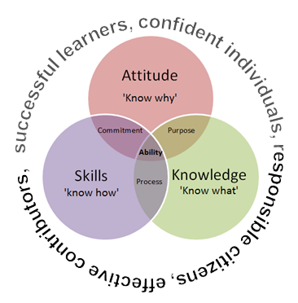
Pedagogy
How do we use this information to facilitate the learning of spelling?
There are three strands of pedagogy that are interconnected.
It is important that we pay attention to each strand and how we deal with each individually and in an interconnected way.
Attitude + skills + knowledge = commitment, purpose, process and ability

Slide 7
Focussing on the Zone of Proximal Development
 How do we do this?
What is known
Zone of proximal development
Skills too difficult for a child to master on his own, but with guidance and encouragement, it can be done.
What is not know

Slide 8
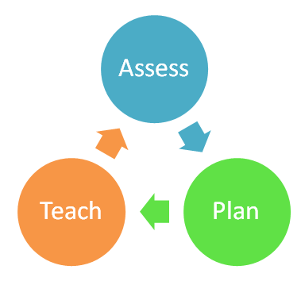
Basic Pedagogy for Teaching Spelling
It is important that spelling is pitched at the correct level and that success is built into the activity.
Minimise distractions (both visual and auditory)
Have a structured learning plan based on assessment
Repetition – small and often over at least three days
Positive cloaking – Make the learning experience as positive as possible
Built in challenge and self-evaluation
Use an active multi-sensory approach

Slide 9
Crown Time
Dialect and accent have a great place in life.
In spelling they can cause problems.
In spelling, if we don’t pronounce words accurately, then it can be difficult to sound out how a word is constructed.
So……
In crown time we speak the Queen’s English.
We must repeat and model good pronunciation when we hear words spoken incorrectly.

Slide 10
Wraparound Spelling - Monday
Use new spelling list for the week.
Say the first word (do not write it yet) in the spelling list and ask the children to count the number of sounds in the word.
Reading goes from concreate to abstract
Spelling goes from abstract to concrete
C-a-t (3 sounds). Ch-a-t (3 sounds)

Slide 11
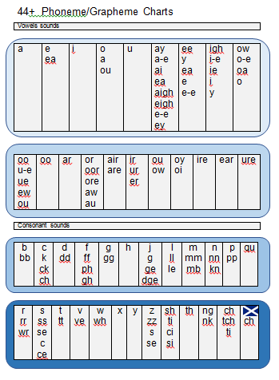
Talk about how you write each sound as you write the word on the board.
Refer to the sound chart for alternative ways of writing a sound. If a sound is made up of more than one letter, these may be referred to as special friends.
i.e. special friends = oo; ee; ch; igh

Slide 12
Stretch with Special friends
Ask the children to identify the ‘special friends’ and underline them.
Model sounding out the word (stretch) and then saying it.
ch – a – t = chat.
Ask the children to repeat it.
Ask the children to attempt to write the word.
Once they have done this, you write it on the board and ask them to tick each correct sound.
✓ ✓ ✓
ch – a – t = chat

Slide 13
Grow the word
Focus word: watch (root)
Growing and shrinking words: watches, watching, watchers, stopwatch, wristwatch etc.
Focus word: photograph
Growing and shrinking words: photographs, photo (prefix), photographer, photogenic
Once you have grown new words with the same code pattern, you can differentiate for groups in your class whilst still teaching one pattern.

Slide 14
Spiral phonics
Doing this means that we are creating an upward spiral of provision so some pupils during the lessen will revise, focus on the lesson and setting the scene for further learning.

Slide 15
The word in context
Ask the children to put the word into a sentence to show what the word means.
Word: watch
Pupil: I have a watch.
Teacher: I have a watch. Why?
Pupil: I have a watch so that I can tell the time.
Teacher: I have a watch so that I can tell the time.
Teacher: How many words are in the sentence?
Pupils: 11

Slide 16
Sentence Structure
Give children the opportunity to hear and rehearse good sentence structure.
Encouraging them to rehearse good sentence structure helps them to write more accurately and not write a stream of consciousness which is often not purposeful or coherent.
If they count the number of words before they write, they can check that none are missing.

Slide 17
A sentence a day
Use one of the sentences and practice each day.
E.g. The kitchen was wet. (Why?)
The kitchen was wet because I left the tap running.
Say the sentence several times. (10)
Ask the children to count the number of words in the sentence.
Ask children to write it down.
Then you write it and ask them to check it. They should tick capital letter and full stop too.
✓✓ ✓ ✓ ✓ ✓ ✓ ✓ ✓ ✓ ✓ ✓
The kitchen was wet because I left the tap running.

Slide 18
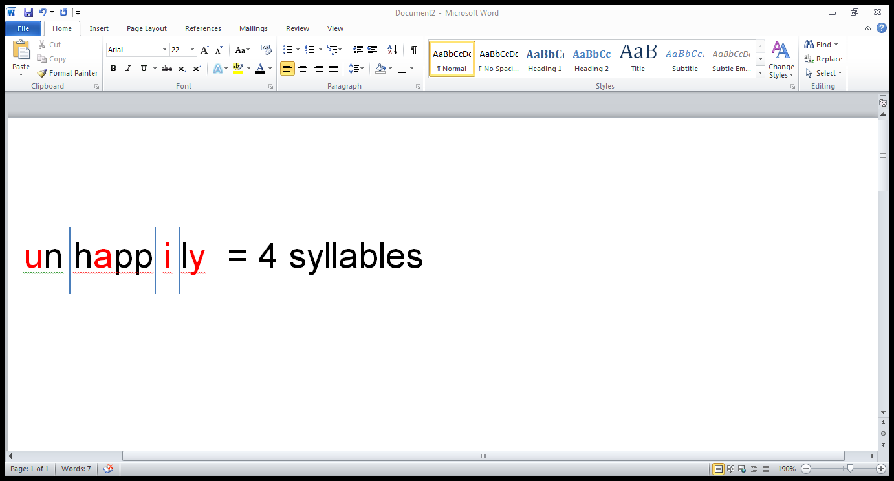
Syllables (Tuesday)
If some of the words have more than one syllable, circle the vowel sounds and clap out the syllables. Draw a dividing line to show syllable divisions.
This is an important strategy for spelling longer words.
Each syllable must contain a vowel sound.

Slide 19
Rhymes (Tuesday)
Ask pupils to look for words which rhyme with the focus word.
Accept nonsense words as well as real words but make sure the pupils know the difference.
This is a useful strategy for reducing the amount of encoding needed in a word if they know how the rhyme in the rhyming word is written.
Take the opportunity (if it arises) to show that some rhymes have different phonic patterns.
e.g. eight and plate

Slide 20
Parts of Speech (Wednesday)
Look at some of the words in the spelling list and show the pupils how to identify the parts of speech. The parts of speech you concentrate on will depend on the stage of your pupils.
First Level: nouns, proper nouns, verbs, adverbs, adjectives
Second Level: +, conjunctions, prepositions, uncountable nouns, collective nouns, contractions, proper adjectives, abstract nouns, articles

Slide 21
Cues (Wednesday)
If there are words that the pupils are finding difficult, then work with them to find a cue to aid memorising it.
i.e. necessary
one collar - two sleeves
It is necessary to have one collar and two sleeves on a shirt.

Slide 22
Cues Cont. (Wednesday)
Because
Big
Elephants
Can
Always
Understand
Small
Elephants

Slide 23
Roots and shoots (Thursday)
This is revising some of the work done on Monday but in more explicit detail by growing and shrinking words by looking for the root word and adding or taking away prefixes and suffixes.
Talk about how the prefixes and suffixes change the meaning of the root word and sometimes the spelling.

Slide 24
Assess and rectify (Friday)
You can assess however you like.
If you have allowed the pupils to choose one of the words that you have grown on Monday, then during the spelling test, you might read out all of the words and let them write down all the ones that they can remember. You could give them a bonus point for each extra word.
There is a bank of games that can be used while you are working with individual groups.

Slide 25
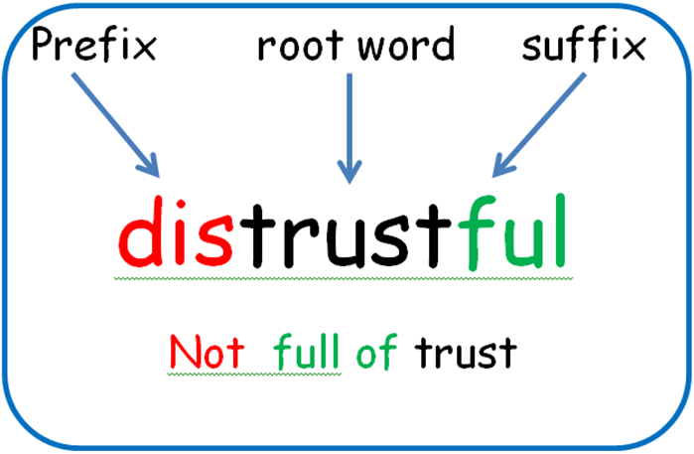
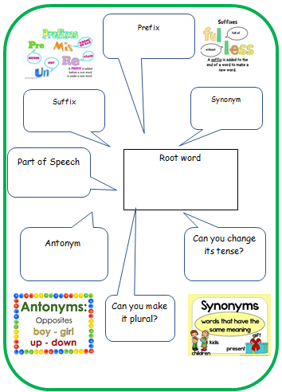
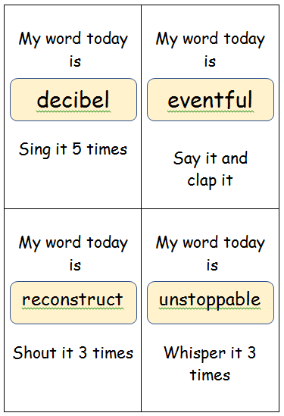
Spelling ideas for whole class
Look, hear, read, say, cover, write, check, repeat (structured spelling scheme)
Wraparound spelling: a pedagogy based structure using the school’s existing scheme or spelling lists
Shared reading: looking through text for phonic patterns, prefixes/ suffixes…..
Word for the day
Word wall
Spelling cue book or displays

Slide 26
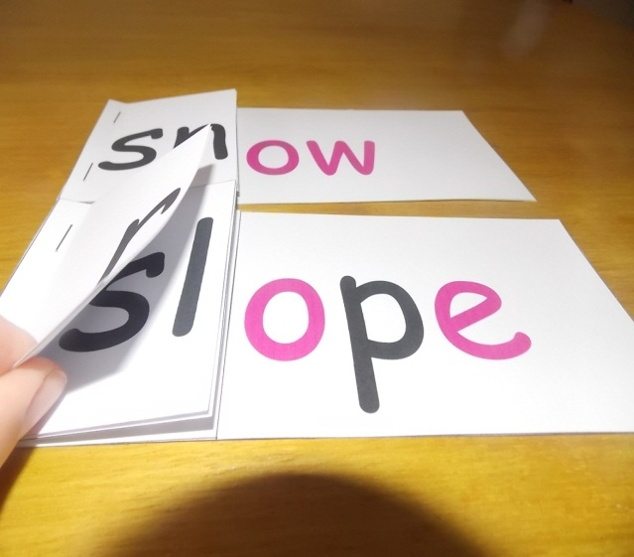
Spelling ideas for group interventions
Phonic Flip books
Compuread and write
Spelling packs
Games
Precision Teaching

Slide 27
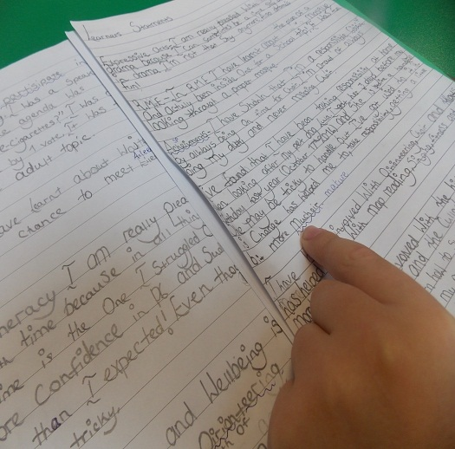
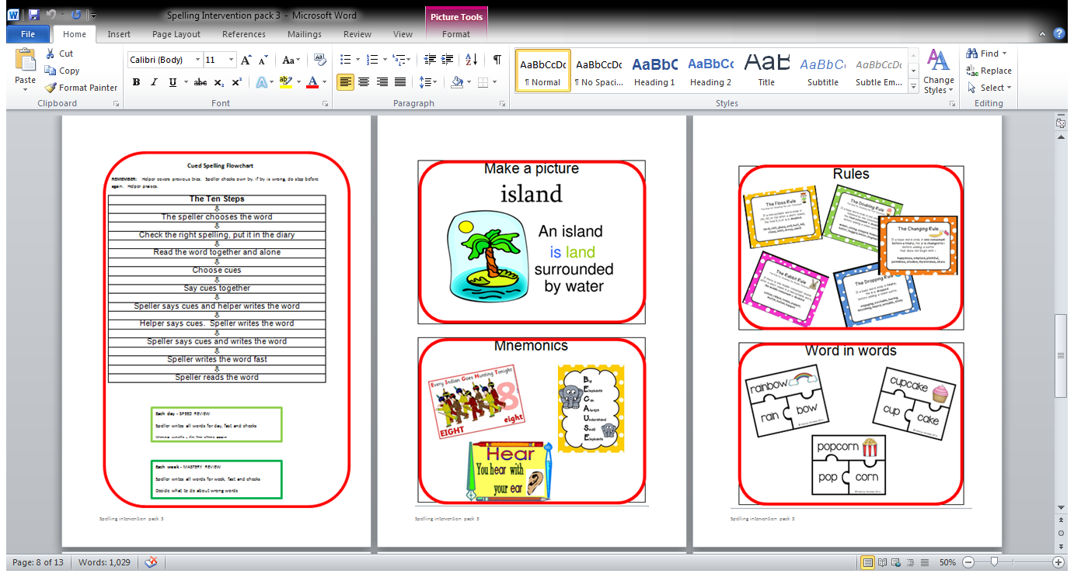
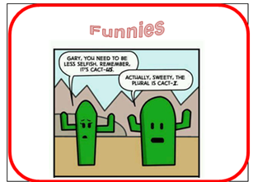
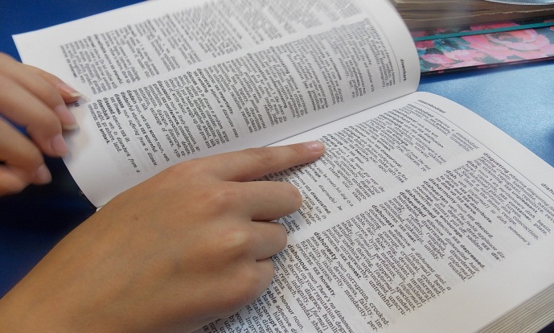
Cued Spelling

Slide 28
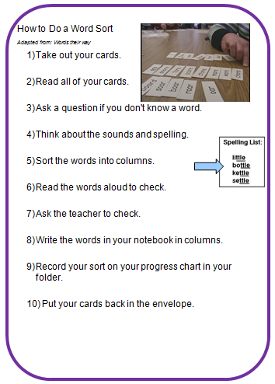
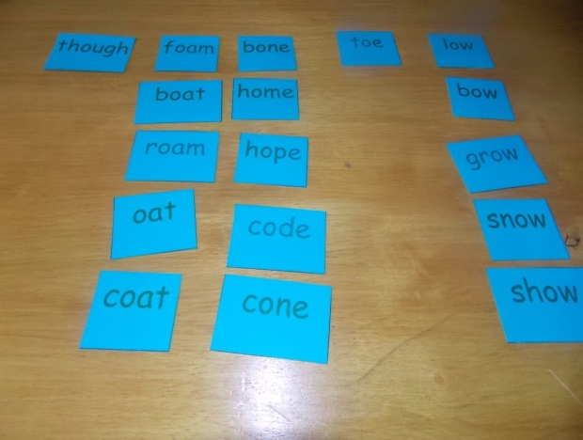
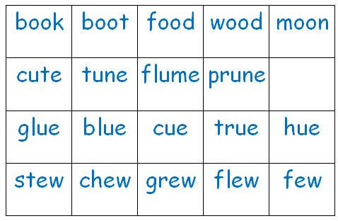
Words Their Way

Slide 29
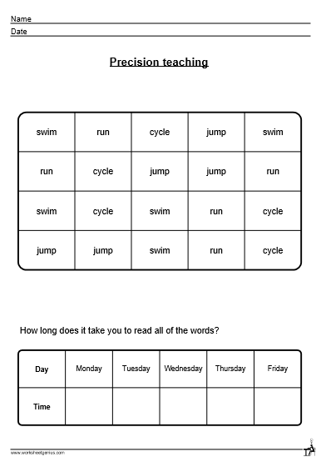
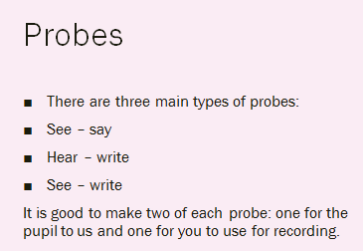
Precision Spelling
Precision Teaching is a method of planning a teaching programme to meet the needs of an individual child or young person who is experiencing difficulty with acquiring or maintaining some skills. It has an inbuilt monitoring function and is basically a means of evaluating the effectiveness of what is being taught whilst providing the element of repetition.
What is known
Zone of proximal development
Skills too difficult for a child to master on his own, but with guidance and encouragement, it can be done.
What is not know

Slide 30
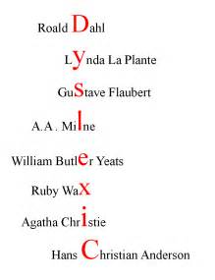
Al teh bets peaple ar……..

Slide 31
Glossary
Alphabetic stage is where a reader understands early phonics.
Grapheme is the written letter that a sound makes.
Logographic stage is where a child memorises the spelling of whole words.
Morphophonology is the awareness that sounds can change when they combine to form words.
Orthographic stage is where a reader’s understanding of abstract code becomes more sophisticated. It includes norms of spelling, hyphenation, capitalization, word breaks, emphasis, and punctuation.
Pedagogy is the method and practice of teaching.
Phoneme is the sound a letter makes.

