Slide 1
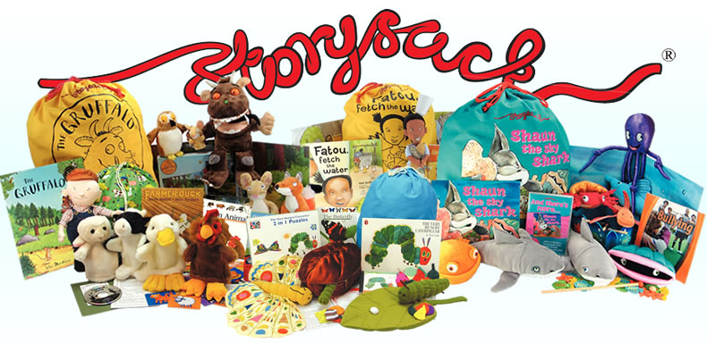

Slide 2
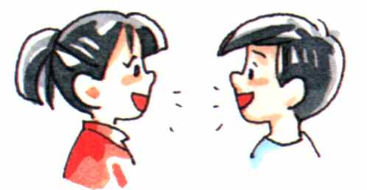
Why Story Sacks?
By ages 3-6— a child’s narrative skills are a powerful predictor of literacy skills at 8-12 years.
By 4 years – the difference in the number of words children from disadvantaged backgrounds hear is 19 million
By 5 years—a child’s vocabulary will predict their education success and outcomes at age 30.
In September 2016’s Phonological Awareness Screening, less than two in ten children in Primary 1 (19.62%) scored nine or more from a possible 12.

Slide 3
What are we doing?
Teachers and staff engage in Literacy CPD – Emerging Literacy, Words Up, Literacy Leaders…
Literacy and Family Learning are key focuses in our School Improvement Plan
Engaged Nursery/P1 parents in Words Up Workshops
Developed Story Sacks using our PEF (Pupil Equity Fund)

Slide 4
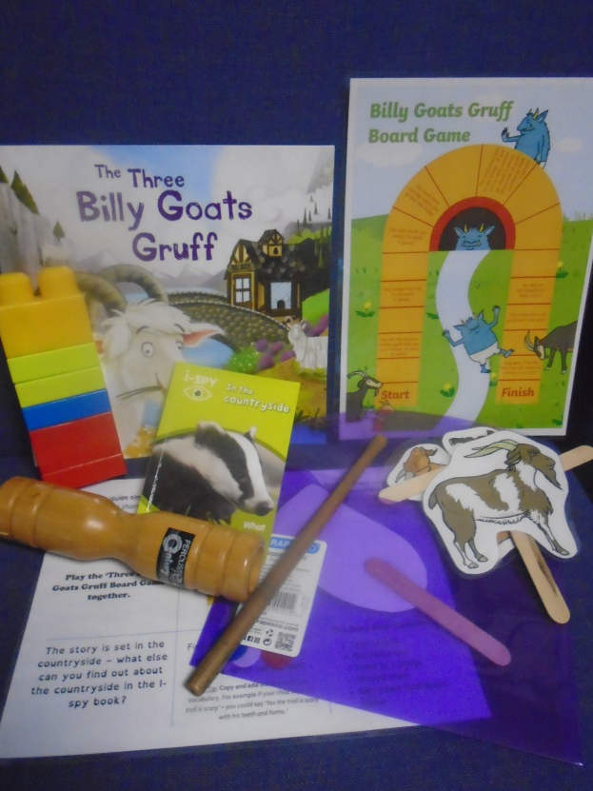
What is a Story Sack?
Essentially a sack full of resources to enjoy alongside and develop a story!
Generally they will contain:
  A copy of the story book
  A related non-fiction text
  Puppets, teddies or characters
  Related games/activities
Issued fortnightly alongside Literacy Homework

Slide 5
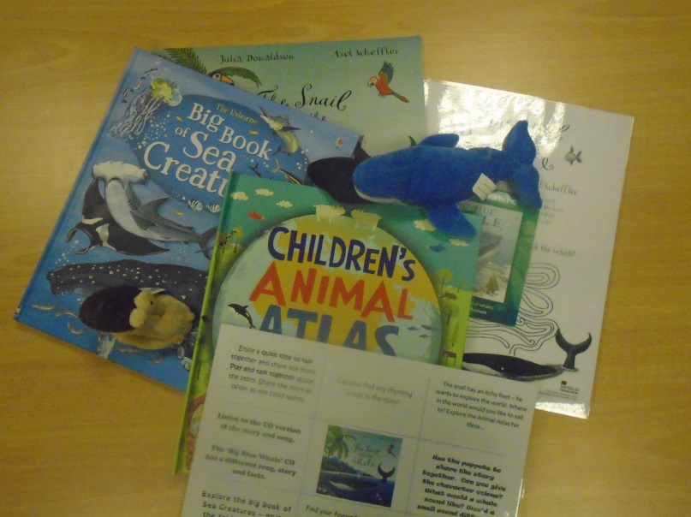
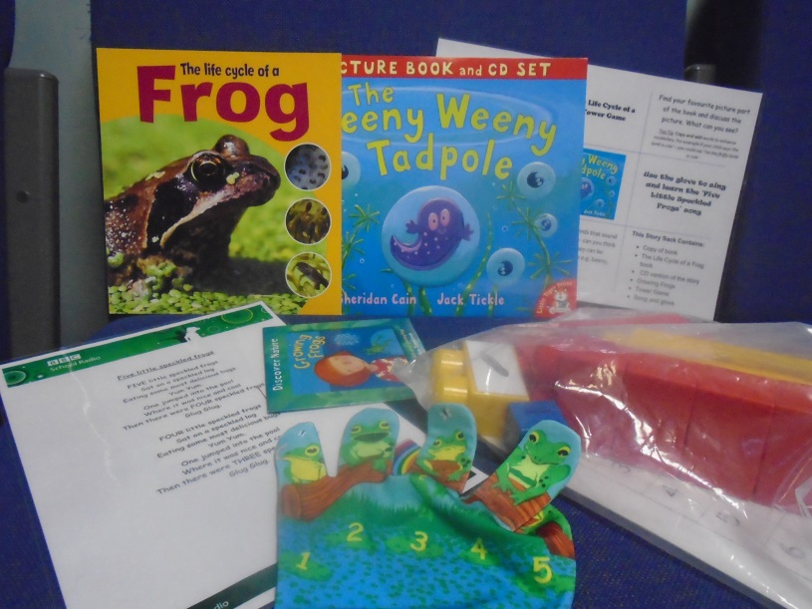
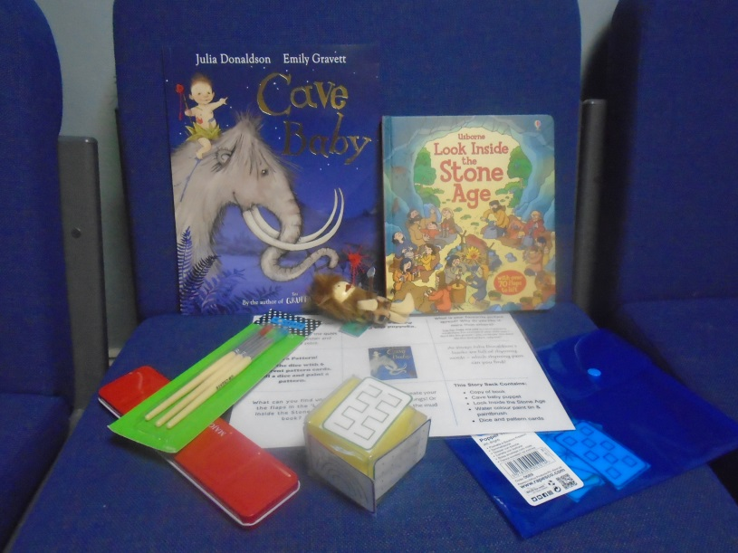
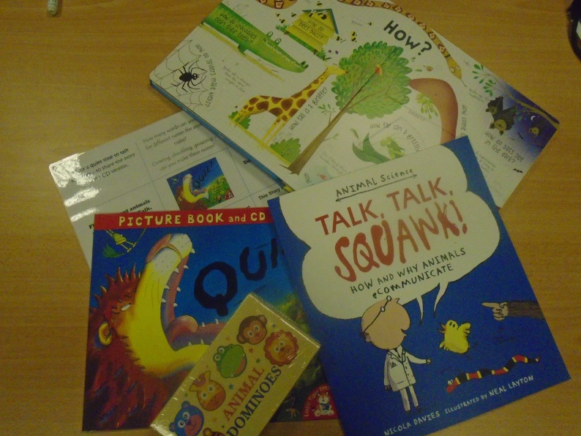
Story Sack Activity Card contains ideas for the resources

Slide 6
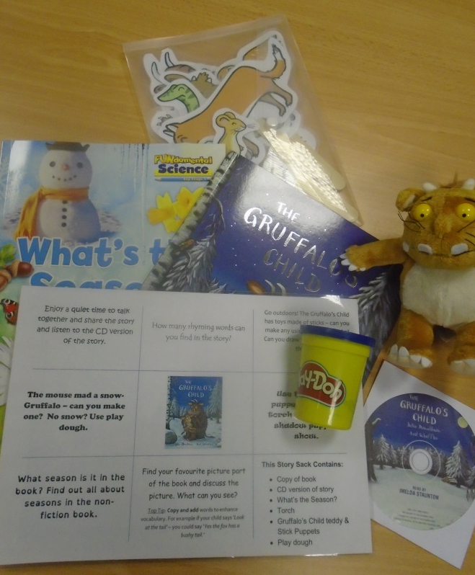
What do Story Sacks promote?
A lifelong love of reading
Development of expressive language
Words Up Key Messages https://highlandliteracy.com/words-up-key-messages/
Use of expression
Vocabulary development and extension
Concepts of print
Fine motor skills
Phonological awareness
Understanding of story—characters, plots, setting
A thirst for learning
Family learning together
A positive reading ethos
Some basic numeracy skills

Slide 7
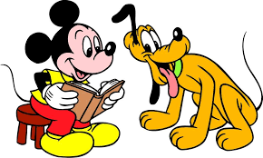
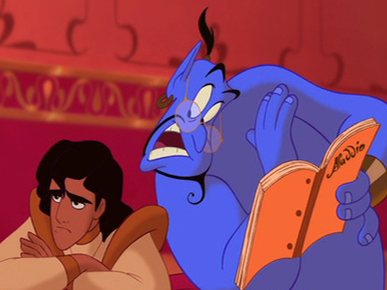
Don’t…
Force a story
Share stories in a stressful environment
These are not homework – do not view them as a chore
Expect your child to read the book
Do…
Make memorable experiences
Enjoy sharing stories
Encourage a love of reading
Share! Share! Share!
Follow the direction the book takes in your house!

Slide 8
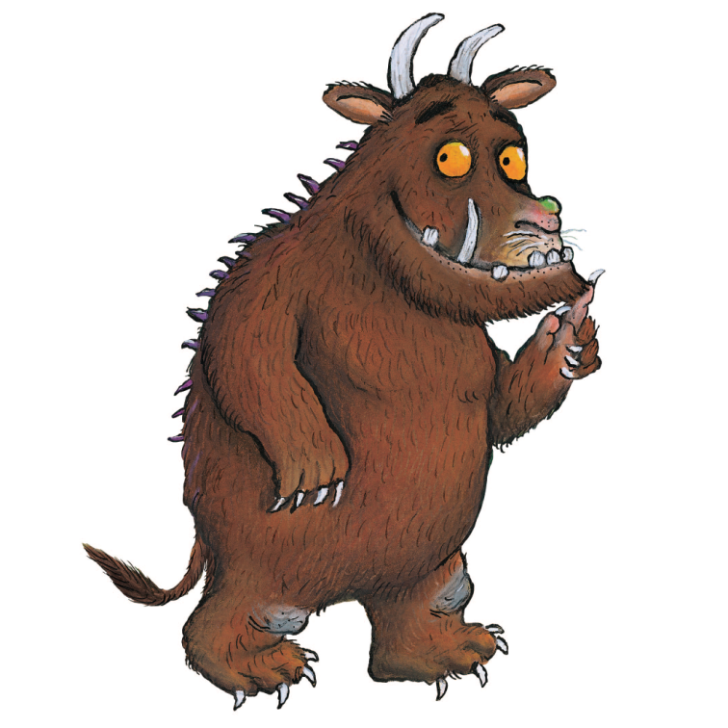
Don’t just take our word for it…
‘I do believe something very magical can happen when you read a good book’
‘I will defend the importance of bedtime stories to my last gasp.’
J.K Rowling
‘Books are uniquely portable magic.’
Stephen King
‘Reading should not be presented to children as a chore or a duty. It should be offered to them as a precious gift. ‘
Kate DiCamillo
‘We have an obligation to read aloud to our children. To read them things they enjoy. To read to them stories we are already tired of. To do the voices, to make it interesting and not to stop reading to them just because they learn to read themselves. ‘
Neil Gaiman
‘Children are made readers on the laps of their parents’
Emilie Buchwald

Slide 9
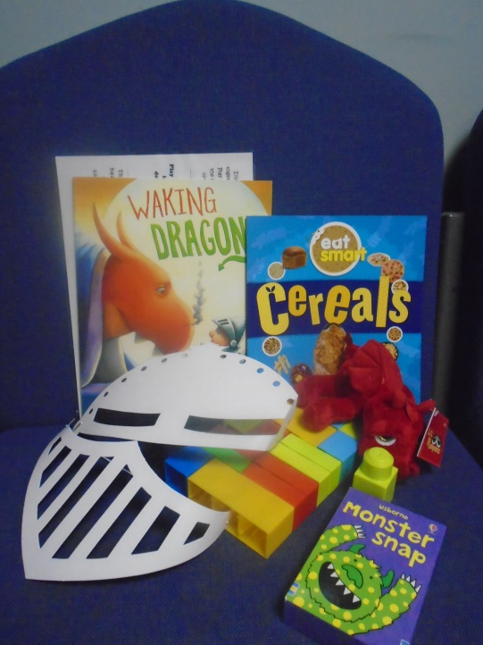
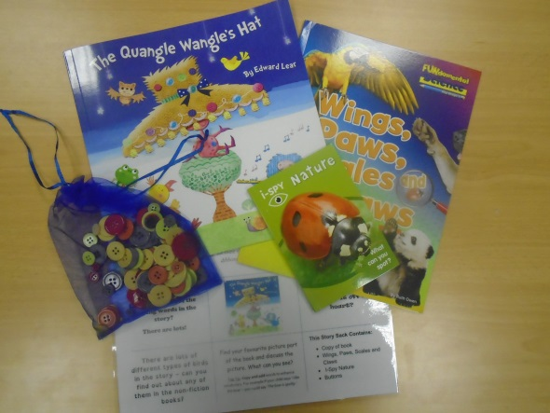
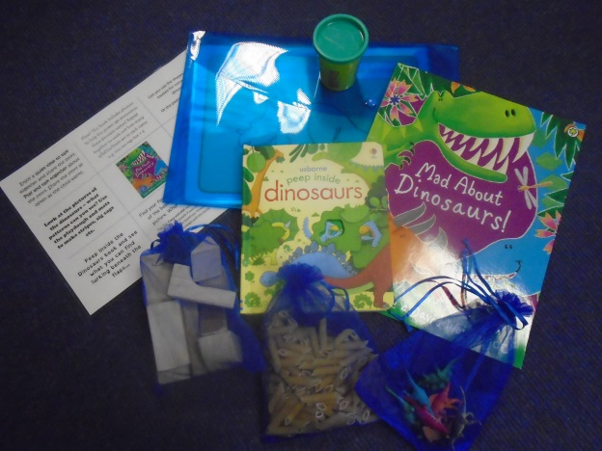
Explore and Enjoy…
Choose your first Story Sack to take home together…
Don’t forget to get your sack signed out by Mrs Pirie before you leave.
Please look after the resources and return the complete sack on time.

