Slide 1
Literacy and English:
Learning, Teaching and Assessment Framework
March 2023
Notes:
This presentation accompanies the Literacy and English: Learning, Teaching and Assessment Framework. The Framework is for those working with children and young people in Early to Second Levels of Curriculum for Excellence.

Slide 2

Notes:
The Framework is built upon the earlier Highland Literacy Steps to Success progression and the Northern Alliance Early Level Literacy and English Progression Tool. It is organised into the three organisers of Listening and Talking, Reading and Writing for each of the CfE Levels Early – Second.
The Framework draws together the Curriculum for Excellence (CfE) Literacy and English Experiences and Outcomes (Es and Os), designed to drive planning for learning, teaching and assessment, and the CfE Benchmarks for Literacy and English, developed to provide clarity on the national standards expected within each curriculum area at every level.

Slide 3
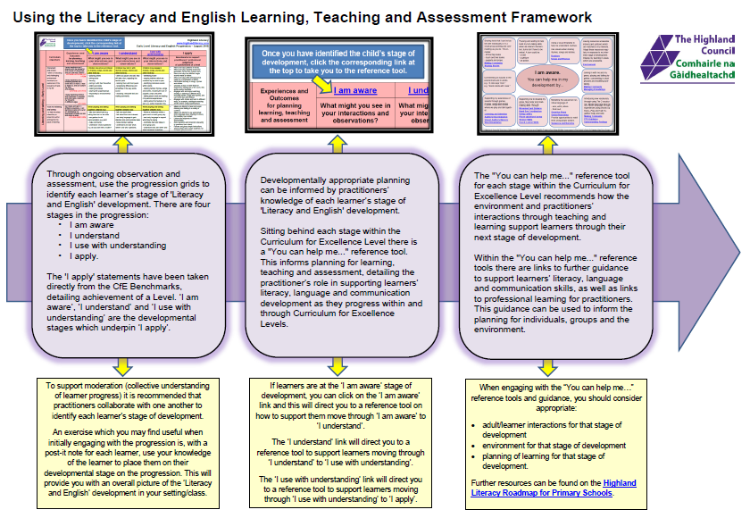
Notes:
The format of the Framework will be familiar to practitioners who have used the Highland Council/ Northern Alliance Early Level Framework which was published in 2018. The 2023 Framework has extended the work of Early Level in to First and Second Levels, using the Curriculum for Excellence Experiences & Outcomes and Benchmarks to support the progress of learning, teaching and assessment within and across Levels.
The Framework has two layers:
The first layer is a progression framework for Early-Second Level Listening and Talking, Reading and Writing. This has been designed to support practitioners’ professional judgement of progression within and through Curriculum for Excellence Levels.
The second layer is the “You Can Help Me Guides”. These have been designed to make links to resources which can be used to support learning and teaching in the classroom.

Slide 4
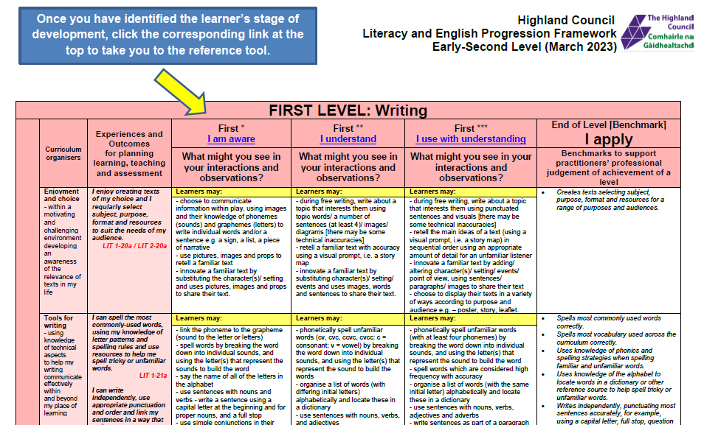
Notes:
There are nine pages of progression - one for listening and talking, reading and writing for Early, First and Second Levels.
Each progression page within the Framework shows the progression through a Curriculum for Excellence (CfE) Level from the beginning stages (I am aware) through to the end of the Level (I apply). The I apply section within the progression is a copy of the CfE Benchmarks detailing achievement at the end of the Level.
These grids outline a progression of what learners may say, make, write and do within and through the CfE Levels. Through observation and assessment, the progression grids can be used to identify and track a learner’s journey within and through CfE Levels.
To support moderation (collective understanding of learner progress) it is recommended that practitioners collaborate with one another to identify each learner’s stage of development.

Slide 5
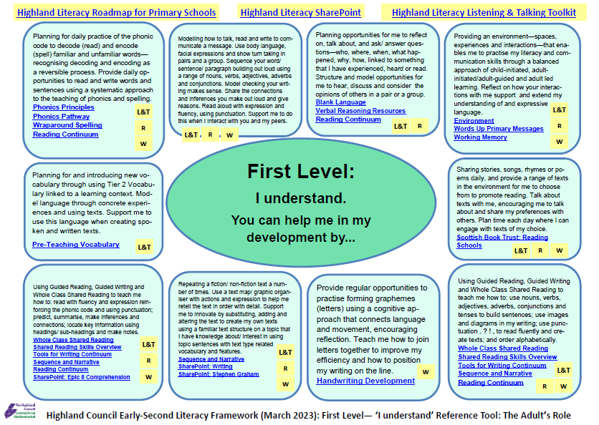
Notes:
The ‘You can help me’ guides have been created to support the planning of learning, teaching and assessment.
For example, if you have identified that learners are at the ‘I understand’ stage of development using the progression grid, you can click on the ‘I understand’ link and this will direct you to a reference tool on how to support them move through ‘I understand’ to ‘I use with understanding’.
The coding for Listening and Talking (L&T), Reading (R) and Writing (W) is used in the ‘You can help me’ guides.
The ‘I am aware’ guide will support learning from ‘I am aware’ to ‘I understand’.
The ‘I understand’ guide will support learning from ‘I understand’ to ‘I use with understanding’
The ‘I use with understanding’ guide will support learning from ‘I use with understanding’ to ‘I apply’.
The ‘You can help me’ guides also include links to resources and professional learning for practitioners.

